Slide 1
BAAR Detail Billing Record Billing
BAAR Phase 3 Training

Slide 2
Welcome!

Slide 3
Table of Contents
Segment 1: Detail Billing Record (DBR) Overview and Key Concepts
Segment 2: DBRs and Associated Batch Processing
Segment 3: DBR Query
Segment 4: Assisted Acquisition Services (AAS) Agreements
Segment 5: Pegasys Billing Transactions Overview
Segment 6: DBR Billing Methods and Resulting Transactions
Segment 7: DBR Billing Processes
Segment 8: Advances
Segment 9: Accruals
Segment 10: Billing-Related Queries
Segment 11: Credit Management
Segment 12: Reports Related to DBR Billing
Segment 13: Mass Import

Slide 4
Segment 1:
Detail Billing Record (DBR) Overview and Key Concepts

Slide 5
Table of Contents
Segment 1: Detail Billing Record (DBR) Overview and Key Concepts
DBR Overview
Billing Process Overview
Segment 2: DBRs and Associated Batch Processing
Segment 3: DBR Query
Segment 4: AAS Agreements
Segment 5: Pegasys Billing Transactions Overview
Segment 6: DBR Billing Methods and Resulting Transactions
Segment 7: DBR Billing Processes
Segment 8: Advances
Segment 9: Accruals
Segment 10: Billing-Related Queries
Segment 11: Credit Management
Segment 12: Reports Related to DBR Billing
Segment 13: Mass Import

Slide 6
Billing and Accounts Receivable (BAAR) Overview
BAAR – Provides GSA the ability to record, monitor, and control all activities associated with GSA’s billing and collection process
Allows GSA to:
Establish unbilled receivables for each billing method
Bill customers for goods/services provided
Track outstanding receivables
Process customer payments (i.e. collections)
Manage delinquent receivables

Slide 7
Detail Billing Records Overview
Detail Billing Records (DBRs) – provide both financial data and non-financial billing detail used to:
Generate Pegasys billing transactions (receivable/revenue)
Generate Pegasys advance/advance offset transactions
Record billing details documenting the goods or services provided to be included on customer statement
Detail Billing Record Creation:
Feeder system interfaces
Manual user creation
DBRs will summarize to create Pegasys billing transactions:
Billing Documents
Internal Vouchers

Slide 8
Billing Methods
Billing Method – defines:
Manner in which GSA initiates customer billing
Manner in which customer remits payment to GSA
GSA bills and receives customer payments via the following billing methods in Phase 3:
Standard Non-IPAC
Transaction between GSA and external Federal/non-Federal customer Customer actively initiates the remittance of payment to GSA via available payment methods NOTE: In some cases, Federal customers may remit payments via IPAC for non-IPAC bills
IPAC
Transaction between GSA and external Federal customer Billing and collection is performed via Treasury’s Intra-Governmental Payment and Collection system Customer payment automatically received by GSA via IPAC Customer does not actively remit payment to GSA
Internal
Transaction between internal GSA business lines Intrafund: Billing within the same GSA Treasury Account Symbol (TAS) (e.g. 455 Fund billing 285 Fund) Interfund: Billing within GSA, but not within the same TAS (e.g. 285/455 paying rent to 192X)

Slide 9
Billing Methods – Non-IPAC
Customer Type: External
Federal and non-Federal customers can be billed non-IPAC
Note: most Federal customers billed via IPAC
GSA generates a customer statement notifying customer of 1) billed charges and 2) collection due date
Non-IPAC bills are not printed -- generated as soft copy PDF and displayed in Pegasys and VCSS
Customer actively remits payment to GSA

Slide 10
Billing Methods – Non-IPAC
Non-IPAC Billing transactions are recorded via Billing Documents in Pegasys
Billing Document (BD) – performs 2 functions for external customer billing:
Facilitates billing for services rendered/goods delivered
Records the financial impact of providing goods/services:
GL Impact: Accounts Receivable and Revenue
Generates customer statement viewable in Pegasys and VCSS
To be viewable in VCSS, the vendor must be registered in VCSS

Slide 11
Billing Methods – IPAC
Intra-Governmental Payment and Collection (IPAC) Interface:
Treasury system facilitating intra-governmental (agency to agency) transfers of funds, which streamlines Billing/Collections for GSA
Customer Type: External
Only Federal customers can be billed via Treasury IPAC system
Note: most Federal customers billed via IPAC
Requires signed trading agreement and related Pegasys configuration
GSA generates a customer statement notifying customer of 1) billed charges and 2) collection due date
IPAC bills are not printed – generated as soft copy PDF and displayed in Pegasys/VCSS
The PDF will only be displayed in VCSS if the vendor is registered in VCSS
Automated collection processing – customer does not actively remit payment

Slide 12
Billing Methods – IPAC
Intra-Governmental Payment and Collection (IPAC) Interface:
Pegasys Outbound process (to Treasury):
Sending the billing information to Treasury
IPAC billing and payment transactions are selected by Pegasys and a file is created that is uploaded to Treasury
Treasury’s Role:
Performs funds transfer requested by GSA
Generates file back to GSA with billing and payment confirmations
Pegasys Inbound process (from Treasury):
Receiving collection/payment confirmations from Treasury
IPAC collections are received for:
Confirmation of IPAC bills sent to the customer via IPAC
Collection of non-IPAC bills where customer chooses to remit payment via IPAC

Slide 13
Billing Methods – Internal
Customer Type: Internal
Only GSA business line customers can be billed internally
Transaction between internal organizations within GSA, where GSA is both the seller and the buyer of goods/services
Interfund vs. Intrafund:
Interfund transactions occur when one GSA Treasury Account Symbol (TSYM) bills another GSA TAS (e.g. 455 paying rent to 192X)
Intrafund transactions occur when the same GSA TSYM bills itself (e.g., Fund 455 bills Fund 255)
Customer statement is not generated or displayed in VCSS
1 step collection processing – customer does not actively remit payment

Slide 14
Billing Methods – Internal
Internal billing transactions are recorded via Internal Vouchers in Pegasys
Internal Voucher (NV) –
Simultaneously records:
Revenue and increase to Cash for the seller
Expense and decrease to Cash for the buyer
Records seller and buyer side transaction information:
Accounting Dimensions
Transaction Types

Slide 15
Billing Vehicles
Billing Vehicle describes:
The method/processes used by GSA to generate customer billing transactions within Pegasys
Can utilize all 3 Billing Methods (IPAC, non-IPAC, Internal)
Phase 3 Billing Vehicles – Automated:
Detail Billing Records (DBRs)
Project Cost Accounting System (PCAS)
DBR/PCAS Hybrid
Phase 3 Billing Vehicles – Manual:
Non-PCAS/Non-DBR

Slide 16
Billing Vehicles
Assisted Acquisition Services (AAS)
All business lines will use the DBR/PCAS Hybrid billing vehicle
Information Technology Services (ITS)
Some business lines will use the standard DBR billing vehicle
Some business lines will use the DBR/PCAS Hybrid billing vehicle

Slide 17
Phase 3 DBR and DBR/PCAS Hybrid Business Lines
Standard DBR Billing Vehicle:
DBR/PCAS Hybrid Billing Vehicle:
Business Line Name | Pegasys Business Line Value
Region 6:
Wide Area Network | ITSWAN
Regional Network Services-Telecom | ITSREGTEL
Business Line Name | Pegasys Business Line Value
Region 6:
National Assisted Acquisition Services | AASFEDSIM
Regional Assisted Acquisition Services | AASREGIT
Integrated Workplace Acquisition Center | IWAC
Regional Network Services - Expanded Services | ITSEXPSER
National IT Commodity Program | ITSNATITCM
HSPD-12 | ITSHSPD12

Slide 18
Standard DBR Receivables Lifecycle
Initiate Billing Records at Feeder System
Establish Detail Billing Records in Pegasys
Generate Receivable and Earned Revenue
Pegasys Connect
FMESB
DBR Import
or
Manual Creation
DBR Crosswalk
DBR Summarization
Accruals
Track Receivable & Record Overdue Charges
Bill Customer
AROVERDUE
ARDUNNING
Accrual Interface
Mass Import
Manual Creation
Credit Application
IPACOUT
ARBILLGEN
Write off/ Adjustment/ Treasury Referral
Disputes -
Chargebacks
Record Collection
IPACIN
LOCKBOX
Pay.Gov via CIR
Manual
IPACIN
Pay.gov via CIR
ARREFERSEL
ARTREOEX
IPACIN
AREOCOLL
Not all steps will apply to every Receivable. These are potential events in the Accounts Receivable Life Cycle.

Slide 19
DBR/PCAS Hybrid Overview
DBR/PCAS Hybrid – uses elements from both PCAS and DBR billing methods
DBR/PCAS Hybrid billing vehicle allows GSA to:
Via the Agreement:
Define the terms and conditions for GSA to provide goods/services to its customer via Pegasys Agreements
Track fulfillment of customer orders (UFCO) by GSA for internal and external customers
Track billing and collections for goods/costs/services
Via the DBR:
Record billing detail documenting the goods or services provided
Generate Pegasys billing transactions (receivable/revenue)

Slide 20
DBR/PCAS Hybrid Lifecycle
Establish Agreement
Initiate Billing Records at Feeder System
Establish Detail Billing Records in Pegasys
Generate Receivable and /or Advance Offset
Record Accrual
Record Collection
Disputes/
Chargebacks
Process Write off/ Adjustment/ Treasury Referral
Bill Customer
Track Receivable & Record Overdue Charges
Agreement Interface
Pegasys Connect
FMESB
DBR Import
DBR Crosswalk
DBR Summarization
IPACIN
LOCKBOX
Pay.Gov via CIR
Manual
AROVERDUE
ARDUNNING
Accrual Interface
Mass Import
Manual Creation
Credit Application
IPACOUT
ARBILLGEN
ARREFERSEL
ARTREOEX
IPACIN
AREOCOLL
Not all steps will apply to every Receivable. These are potential events in the Accounts Receivable (AR) Life Cycle.
IPACIN
Pay.gov via CIR
CGI Federal Proprietary and Confidential

Slide 21
DBR Batch Processing Overview
Detail Billing Records for all billing methods and vehicles will be:
Imported – Loaded into Pegasys from external billing systems
Crosswalked – Pegasys specific field values are derived based on established rules in the system
Summarized – Pegasys billing transaction processed
DBR Import
DBR Crosswalk
DBR Summarization
Billing Documents and Internal Vouchers are created
Manually Add or Edit DBR

Slide 22
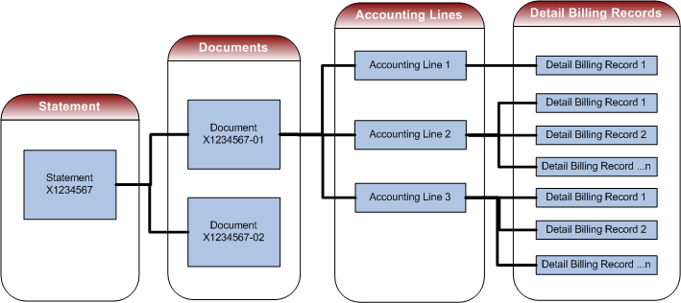
DBR Billing Structure
Notes:
Explain relationship between Statement, document, Accounting Lines, and detail billing records

Slide 23
Segment 2:
DBRs and Associated Batch Processing

Slide 24
Table of Contents
Segment 1: Detail Billing Record (DBR) Overview and Key Concepts
Segment 2: DBRs and Associated Batch Processing
DBR Defined
DBR Import
DBR Crosswalk
DBR Summarization
Segment 3: DBR Query
Segment 4: AAS Agreements
Segment 5: Pegasys Billing Transactions Overview
Segment 6: DBR Billing Methods and Resulting Transactions
Segment 7: DBR Billing Processes
Segment 8: Advances
Segment 9: Accruals
Segment 10: Billing-Related Queries
Segment 11: Credit Management
Segment 12: Reports Related to DBR Billing
Segment 13: Mass Import

Slide 25
Detail Billing Records
Detail Billing Records (DBRs) provide both financial data and non-financial billing detail used to:
Generate Pegasys billing transactions (receivable/revenue)
Generate Pegasys advance/advance offset transactions
Record billing detail documenting the goods or services provided to be included on the customer statement
Pegasys Detail Billing Record Table
Detail Billing Records are stored on the Detail Billing Record Table within Pegasys
The table contains a total of 200 agency defined fields to store GSA specific data
Detail Billing Record processes include:
Loading Detail Billing Records
Manually Adding and Editing Detail Billing Records
Crosswalking Detail Billing Records
Summarizing Detail Billing Records

Slide 26
DBRs – Shared vs. Unshared
Shared vs. Unshared Fields
Detail Billing Records include shared & unshared fields:
Shared fields: Detail Billing Record fields that are also present on the document header or accounting lines of BD/NVs
The value of these fields cannot be changed once a DBR has been associated to a document
Example: Document Type, Fund, Agreement Number
Unshared fields: Fields that are on the Detail Billing Record only (used to store non-financial information)
Example: Original Record ID, Bill Level Indicator, Advance Indicator

Slide 27
DBRs – Associated vs. Non-Associated
Associated vs. Non-Associated Detail Billing Records
Associated records: DBRs that are associated with, or linked to, a document accounting line
DBRs can be associated with a document through Summarization or by a user manually adding them from within the document
Non-associated records: DBRs that are not associated with a document, also known as “orphan records”
Non-associated DBRs are created by:
DBR import process
Manual creation via the Detail Billing Record Query

Slide 28
DBR Lifecycle
Detail Billing Record
Import
Detail Billing Record Crosswalk
Detail Billing Record Summarization
DBRs loaded into Pegasys via DBR Import
Detail Billing Records
For
IPAC | Non-IPAC | Internal Vouchers
Processed by
DBR IMPORT
Pegasys specific fields filled in by Crosswalk
Values in “From” Fields
Determines
Values in “To” Fields
Processed by
CROSSWALK
Like DBRs grouped to create BD or NV
Detail Billing Records
Are Grouped
By Identical values in specific fields creating Documents and Accounting Lines
Processed by
SUMMARIZATION

Slide 29
DBR Entry Methods
Manual Creation:
Create New
Copy from existing
Import via Interface:
AAS DBR Interface
Billing Vehicle: DBR/PCAS Hybrid
Telecom/WAN Interface
Billing Vehicle: DBR

Slide 30
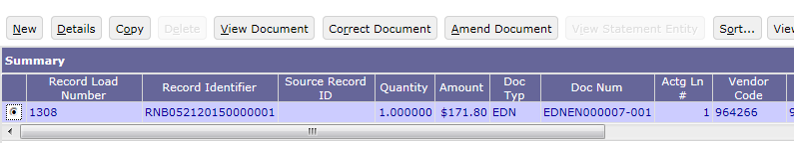
DBR Entry Methods
Manually enter new DBRs
Create New – from scratch
Select New button
Populate all required fields on Detail Billing Record
Create New – copy from existing and alter field values
Search for intended Detail Billing Record to Copy
Select item from Item Collection
Select Copy button
Notes:
The Detail Billing Record contains 3 tabs:
Accounting Elements (Detail Record Values) tab
Contains the original values of the shared fields of the Detail Billing Record (the value stored on the Detail Billing Record Table)
Example: External System ID, Vendor Code, Source Number
Detail Billing Element Fields tab
Contains the Detail Billing Record specific fields, the non-shared fields
Example: Original Record ID, Routing Number, Surcharge Indicator
Accounting Elements (Document Level Values) tab
Document Level Values are populated when Crosswalk is complete
Contains the current values of the Shared Fields of the Detail Billing Record (the value stored on the Associated document if applicable)
Example: The Accounting Elements, Line Type, Receivable Type

Slide 31
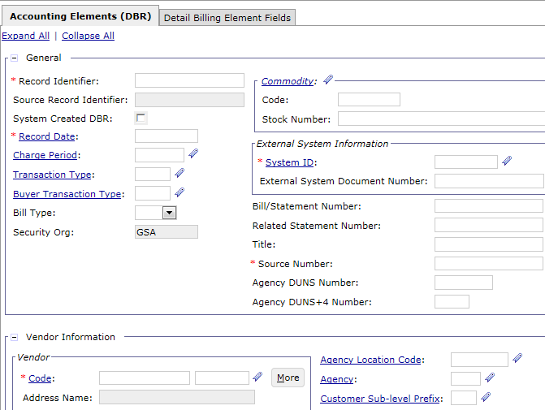
DBR – General and Vendor Fields
General fields
Record Identifier
Record Date
External System ID
Source Number
Vendor (Customer) Information
Vendor Code

Slide 32
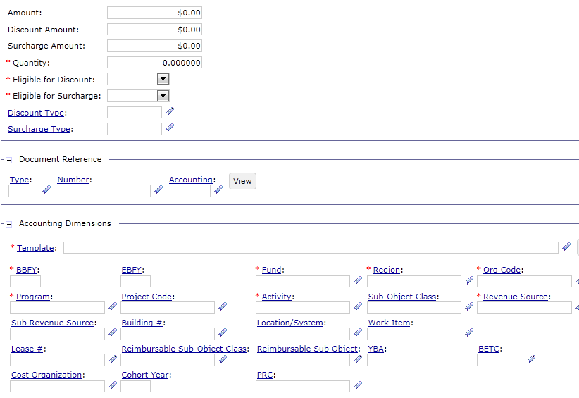
DBR – Amounts and Accounting Fields
Amount fields
Amount
Quantity
Eligible for Discount
Eligible for Surcharge
Accounting Dimensions
Template
For Interfund/Intrafund DBRs, the Seller’s Accounting Dimensions

Slide 33
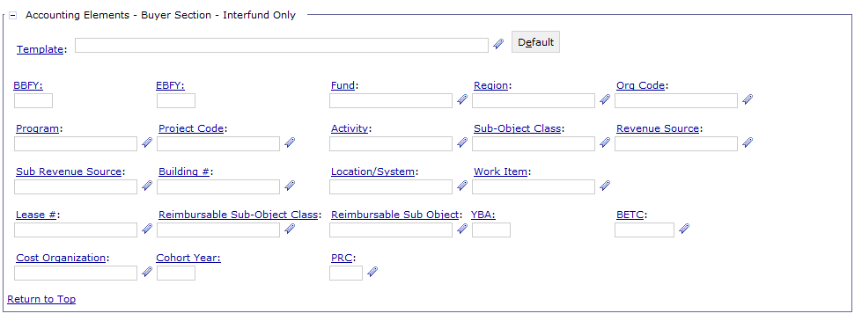
DBR – Internal Voucher Accounting fields
Populated for Internal DBRs only
Accounting Elements
Template
For Interfund/Intrafund DBRs, the Buyer’s Accounting Dimensions

Slide 34
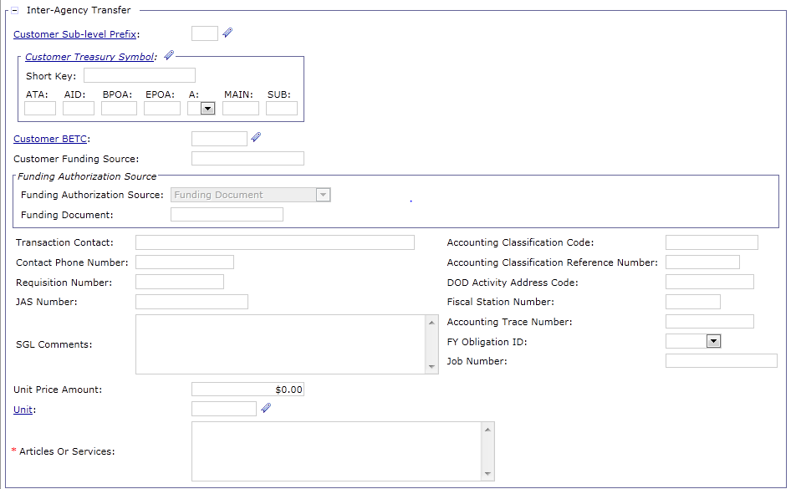
DBR – IPAC Fields
IPAC Fields:
Customer Funding Source
Requisition Number
JAS Number
Unit and Unit Price Amount
Articles or Services
Accounting Classification Code
Accounting Classification Reference Number
Fiscal Station Number

Slide 35
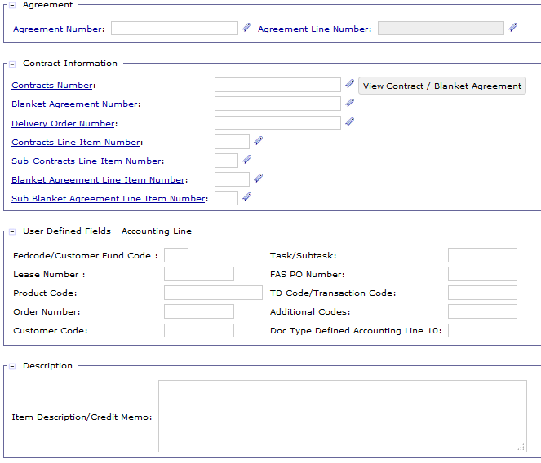
DBR – User-Defined Fields and Description
Agreement fields
Required for Hybrid DBR/PCAS Business Lines
Task/Subtask
From NBA/RBA component systems; comes in through interface
NBA only uses Task; no Subtask

Slide 36
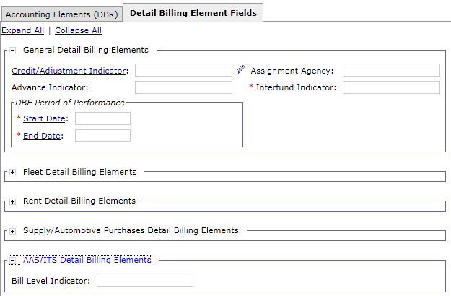
DBR – Detail Billing Elements Fields
General Detail Billing Elements:
Credit/Adjustment Indicator
Advance Indicator
Interfund Indicator
DBE Period of Performance
AAS/ITS Detail Billing Elements:
Bill Level Indicator

Slide 37
DBR Lifecycle
Detail Billing Record
Import
Detail Billing Record Crosswalk
Detail Billing Record Summarization
DBRs loaded into Pegasys via DBR Import
Detail Billing Records
For
IPAC | Non-IPAC | Internal Vouchers
Processed by
DBR IMPORT
Pegasys specific fields filled in by Crosswalk
Values in “From” Fields
Determines
Values in “To” Fields
Processed by
CROSSWALK
Like DBRs grouped to create BD or NV
Detail Billing Records
Are Grouped
By Identical values in specific fields creating Documents and Accounting Lines
Processed by
SUMMARIZATION

Slide 38
Detail Billing Record Summary
Pre-Pegasys
j
k
National Billing Address System (NABAS)
(To be retired in 2016, following BAAR Wave 3.4)
Customer Address File (CAF)
Vendor Data
TOPS/WITS Address File
Pegasys
Billing Feeder Systems
l
Accounts Receivable and Billing
Unbilled Receivable
Management
Billing
Billing Receivable Management
and Collections
Delinquency Management
General Ledger
Customer Maintenance
Budget
Purchasing/Payables
Custom Reporting
Fleet Management System (FMS)
OA Billing
FSS-19
RETA
EMS2000
SIFT
CSC
FEDPAY
NCSC
OATOOL (Outlease)
CARS (Vehicle Claims)
TOPS
WITS
EMORRIS
RBA
NBA
FM ESB
Collections
Pegasys Connect
Lockbox
Pay.gov/CIR
IPAC
EFT (Wire, ACH REX)
Credit Card Bank/TRS
Vendor/Customer Self-Service (VCSS)
DoD Interfund
Contract Fees
Notes:
Items in red are new feeder systems or refer to the collection methods to be used with the implementation of BAAR Phase 3. DBRs for AAS will be imported from RBA and NBA. DBRs for Telecom will be imported from TOPS, WITS, and EMORRIS.

Slide 39
DBR Import Batch Process
The Import Detail Billing Records process allows feeder system records to be transmitted into Pegasys
Valid feeder system records are imported as DBRs within Pegasys
Submitted reference backed fields contain valid values on the associated reference table
DBRS are non-associated when Imported
Creates 2 output files:
Positive confirmation (accepted records) file
Negative confirmation (rejected records) file
Frequency:
AAS/ITS AASARDBIMPORT will run Import on a daily basis
Telecom/WAN TLCARDBIMPORT will run Import on Day 23 and then daily through the end of the month
DBR Import
DBR Crosswalk
DBR Summarization
Billing Documents and Internal Vouchers are created
Manually Add or Edit DBR

Slide 40
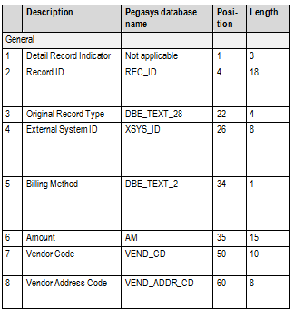
Detail Billing Record Import File
Detail Billing Records contain transactional pieces of information from the source systems*
General – basic identifying information
Accounting – accounting dimensions and related fields
GSA Interfund/Intrafund – fields specific to GSA Interfund/Intrafund transactions
Mostly IPAC-related – fields that support IPAC transactions but also populated for other transactions
Technical – optional fields that affect processing and the values returned in the response files
Transaction Details – Detail Billing Elements
Detail Billing Records have a fixed length format within the import file
*The AAS and Telecom Billing DES documents can be referred to for a complete list of fields included on the DBRs received from the FMESB

Slide 41

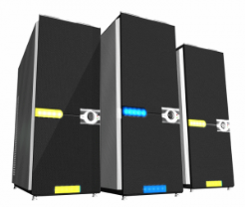

AAS Interface Overview
NBA Business Lines (DBR/PCAS Hybrid):
HSPD-12 (ITSHSPD12)
AAS - National - FEDSIM (AASFedSim)
DBR Files
FMESB performs batch control edits and transfers file to Pegasys
Detail Billing Processes executed against file
Outbound Return Files to the ASSIST module via FMESB
The ASSIST module combines data and generates DBR files
Pegasys Batch Controls validates file against batch controls parameters and database
NBA Source System
RBA Source System
RBA Business Lines (DBR/PCAS Hybrid):
AAS - Regional - IT (AASREGIT)
AAS - Integrated Workplace Acquisition Center (IWAC)
ITS - Regional Network Services-Expanded Services (ITSEXPSER)
National IT Commodity Program (ITSNATITCM)
DBR Import
Crosswalk
Summarization
Detail Billing Processes

Slide 42
AAS DBR Summary
Feeder Systems:
ASSIST Module
Regional Business Application (RBA)
National Business Application (NBA)
Business Lines:
Business Line Name | Pegasys Business Line Value
RBA:
Regional Assisted Acquisition Services | AASREGIT
Integrated Workplace Acquisition Center | IWAC
Regional Network Services - Expanded Services | ITSEXPSER
National IT Commodity Program | ITSNATITCM
NBA:
National Assisted Acquisition Services | AASFEDSIM
HSPD-12 | ITSHSPD12

Slide 43
AAS DBR Attributes
Billing Methods:
Non Federal – Non-IPAC
Federal – Non-IPAC/IPAC/Interfund
Billing Vehicle – DBR/PCAS Hybrid:
Bills generated via DBRs
DBRs will contain an Agreement reference
DBRs associated to the Agreement will be viewable through the Billing Documents or Internal Vouchers referencing the Agreement
Bills generated semi-monthly (2x/month)
Advances and Advance Offsets
Receivables Lifecycle
DBR/PCAS Hybrid Receivables Lifecycle is used to support the processing of AAS Agreements, DBRs and other associated transactions

Slide 44
Telecom/WAN Interface Overview
TOPS
WITS
Billing
Record Files
eMorris
DBR Files
FMESB performs batch control edits and transfers file to Pegasys
Detail Billing Processes executed against file
Outbound Return Files to FAS via FMESB
FAS Financial Interface/ Pegasys Connect combines data and generates DBR files
Pegasys Batch Controls validates file against batch controls parameters and database
Business Lines:
Regional Network Services-Telecom (ITSREGTEL)
Wide Area Network - (ITSWAN)
DBR Import
Crosswalk
Summarization
Detail Billing Processes

Slide 45
Telecom/WAN DBR Summary
Feeder Systems:
Pegasys Connect Module
Telecom Ordering and Pricing System (TOPS)
Washington Interagency Telecommunications System (WITS)
Enhanced Monthly On-Line Records and Reports of Information Technology Service (E-MORRIS)
Business Lines:
Business Line Name | Pegasys Business Line Value
TOPS and WITS:
Regional Network Services-Telecom | ITSREGTEL
E-MORRIS:
Wide Area Network | ITSWAN

Slide 46
Telecom/WAN DBR Attributes
Bill Methods
Non Federal – Non-IPAC
Federal – Non-IPAC/IPAC/Interfund
Billing Vehicle
Bills generated via DBRs
Bills generated monthly
Receivables Lifecycle
DBR Receivables Lifecycle is used to support the processing of Telecom and Wan DBRs and other associated transactions

Slide 47
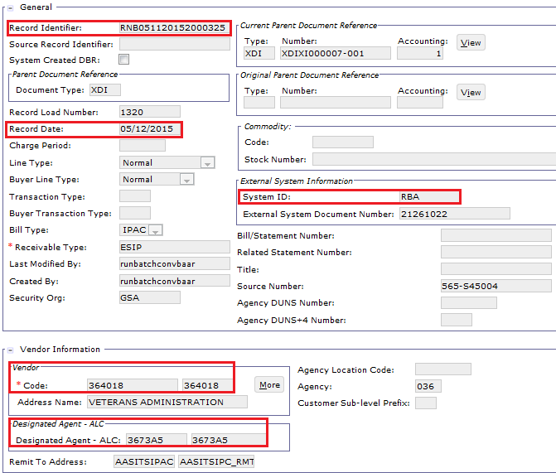
DBR – General and Vendor Fields
General fields
Record Identifier
Record Date
External System ID
Vendor Information
Vendor Code
Also known as BOAC2 (i.e., the recipient of the goods/services
Designated Agent – ALC
AAS and WAN will populate with BOAC1 (i.e., the recipient of the bill) if applicable
Not the ALC of the Vendor Code
If blank, BOAC2 is the same as BOAC1
Notes:
For AAS and WAN, the Designated Agent field will not be ALC. AAS and WAN have a concept called BOAC1 and BOAC2. BOAC1 is the recipient of the goods/services and corresponds to the Vendor Code and Vendor Address Code in Pegasys. Another agency might be actually paying for the goods and services, which is the BOAC2. BOAC2’s Code and Address Code will be in the Designated Agent fields for AAS and WAN. If BOAC1 the same as BOAC2, AAS will have a blank Designated Agency value, but WAN will likely repeat the value in the Designated Agent fields.

Slide 48
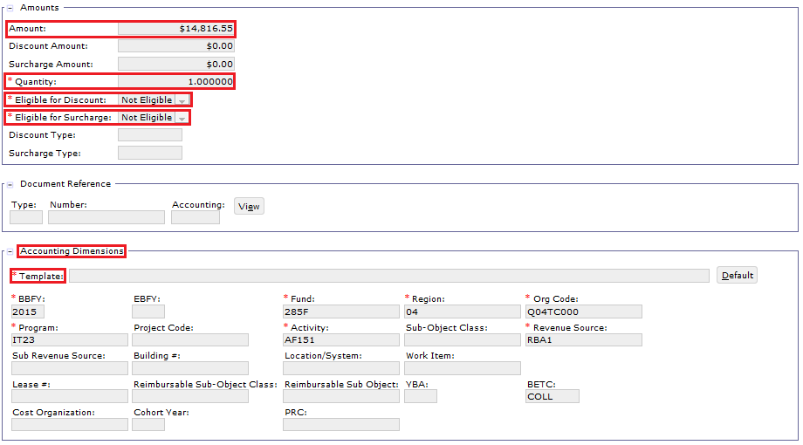
DBR – Amounts and Accounting Fields
Amount fields
Amount
Quantity
Eligible for Discount
Eligible for Surcharge
Accounting Dimensions
Template

Slide 49
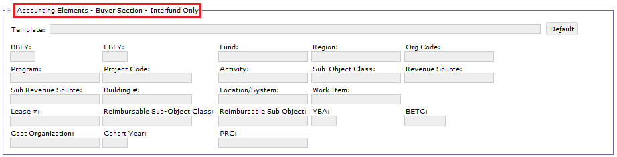
DBR – Internal Fields
Populated for Internal DBRs only
Accounting Elements
Template
For Interfund/Intrafund DBRs, the Buyer’s Accounting Dimensions

Slide 50
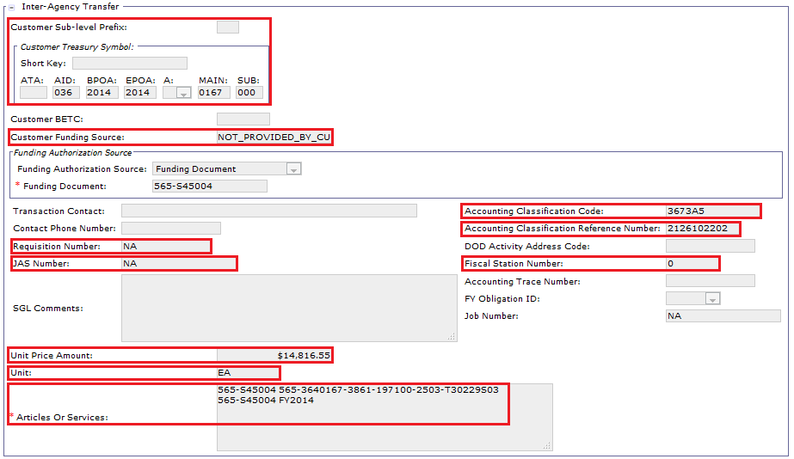
DBR – IPAC Fields
IPAC fields
Customer Treasury Symbol components
Customer Funding Source
Requisition Number
JAS Number
Unit and Unit Price Amount
Articles or Services
Accounting Classification Code
Accounting Classification Reference Number
Fiscal Station Number

Slide 51
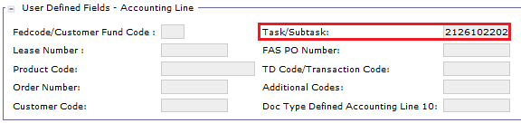
DBR – User-Defined Fields and Description
Task/Subtask
From NBA/RBA component systems; comes in through interface
NBA only uses Task; no Subtask

Slide 52
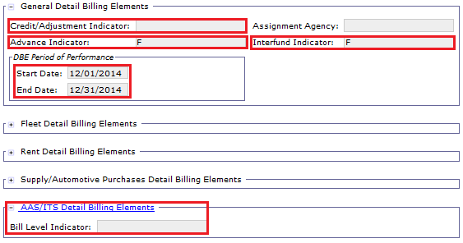
DBR – Detail Billing Elements Fields
General Detail Billing Elements:
Credit/Adjustment Indicator
Advance Indicator
Interfund Indicator
DBE Period of Performance
AAS/ITS Detail Billing Elements:
Bill Level Indicator

Slide 53
AAS/ITS Record vs. Telecom/WAN Record
 | Description | AAS/ITS Record | Telecom/WAN Record
 | Detail Record Indicator | DTL | DTL
 | Record ID | "RNB” + MMDDYYYY####### | "TLC" + MMDDYYYY#######
 | External System ID | NBA RBA | TOPS WITS EMORRIS
 | Amount | 000000000100.99 -000000000100.99 | 000000000100.99 -000000000100.99
 | Vendor (Customer) Code | [BOAC2] | TOPS/WITS: “T-“ + [Customer Number BOAC] E-MORRIS: [BOAC2]
 | Designated Agent Code | If [BOAC1] is not the same as [BOAC2], set to [BOAC1] Otherwise, leave blank | TOPS/WITS: If [Bill Level ID] is “B” or blank, leave blank If [Bill Level ID] is “A” or “C”, set to [Customer ALC] E-MORRIS: If [BOAC1] does not equal [BOAC2, set to [BOAC1] Otherwise, leave blank
 | Billing Method | Leave blank | TOPS/WITS: If [Bill Statement Number] starts with J, set to “IPAC” If [Bill Statement Number] starts with B, leave blank (which equates to non-IPAC billing) E-MORRIS: leave blank
Please refer to the AAS Billing DES and Telecom Billing DES for comprehensive
field comparisons
Fields in brackets (e.g., [BOAC1]) refer to fields in the corresponding feeder system
Notes:
The RBA, NBA, and EMORRIS feeder systems do not supply billing method. For the associated business lines, the TYP_OF_AGCY_TRFR is derived from the vendor (or the designated agent if one is supplied). For TOPS/WITS, the TYP_OF_AGCY_TRFR is provided explicitly. For TOPS/WITS, the TYP_OF_AGCY_TRFR (if IPAC) would also default from the vendor if DBLOAD left it null, but the telecom vendors (T- prefix vendor codes) will never have TYP_OF_AGCY_TRFR set.

Slide 54
AAS/ITS Record vs. Telecom/WAN Record
 | Description | AAS/ITS Record | Telecom/WAN Record
 | External System Document Number | ACT_NO on the FMIS VAT | TOPS/WITS: leave blank E-MORRIS: [Task Order/Cust. ID]
 | Agreement Number | For RBA, set to “X” + RBA-assigned unique value For NBA, set to “Z” + NBA-assigned unique value | n/a
 | Agreement Line Number | 1 | n/a
 | Credit Indicator | If [Credit Bill Indicator] is blank, leave blank If [Credit Bill Indicator] = Y, set to “C” | If [Credit Bill Indicator is blank, leave blank If [Credit Bill Indicator = Y, set to “C”
 | Advance Indicator | "T" for advance “O” for advance offset "F" otherwise | "T" for advance "F" otherwise Required. This field is provided for potential future use. For the BAAR Phase 3 implementation, it will always be set to “F”.
 | Interfund Indicator | If [Transaction Type] is N, set to “F” If [Transaction Type] is Y, set to “A” for intrafund transactions or “T” for interfund | TOPS/WITS: If [Interfund Ind] is blank, set to “F” If [Interfund Ind] is Y, set to “A” for intrafund transactions or “T” for interfund transactions E-MORRIS If [Transaction Type] is N, set to “F” If [Transaction Type] is Y, set to “A” for intrafund transactions or “T” for interfund transactions
Please refer to the AAS Billing DES and Telecom Billing DES for comprehensive
field comparisons
Fields in brackets (e.g., [BOAC1]) refer to fields in the corresponding feeder system

Slide 55
AAS/ITS Record vs. Telecom/WAN Record
 | Description | AAS/ITS Record | Telecom/WAN Record
 | Accounting Classification Code | [BOAC1] | TOPS/WITS: “T-“ + [Customer Number BOAC] E-MORRIS: [BOAC1]
 | Accounting Classification Reference Number | [Task Order/Cust. ID] + [Subtask] [Subtask] is not used for NBA, so this field will contain only [Task Order/Cust. ID] for NBA | TOPS/WITS: leave blank E-MORRIS: [Task Order/Cust. ID] + [Subtask]
 | Articles or Services Description | If the Interfund Indicator is F, set to [Cust. Purchase Order] Otherwise, leave blank | TOPS/WITS: If the [Interfund Ind] is blank, set to [Customer LOA] If the [Interfund Ind] is Y, leave blank. E-MORRIS: If the [Transaction Type] is N, populate as shown in Exhibit 5‑9 If the [Transaction Type] is Y, leave blank
 | Customer ALC | Leave blank | TOPS/WITS: [Customer ALC] E-MORRIS: leave blank
 | Quantity | 1 | 1
 | Unit of Issue | EA | EA
 | Description of Services | The first 22 characters are mapped to the Purchase Order field in the IPAC Bulk file | TOPS/WITS: leave blank E-MORRIS: [Description of Services]
Please refer to the AAS Billing DES and Telecom Billing DES for comprehensive
field comparisons
Fields in brackets (e.g., [BOAC1]) refer to fields in the corresponding feeder system

Slide 56
DBR Lifecycle
Detail Billing Record
Import
Detail Billing Record Crosswalk
Detail Billing Record Summarization
DBRs loaded into Pegasys via DBR Import
Detail Billing Records
For
IPAC | Non-IPAC | Internal Vouchers
Processed by
DBR IMPORT
Pegasys specific fields filled in by Crosswalk
Values in “From” Fields
Determines
Values in “To” Fields
Processed by
CROSSWALK
Like DBRs grouped to create BD or NV
Detail Billing Records
Are Grouped
By Identical values in specific fields creating Documents and Accounting Lines
Processed by
SUMMARIZATION

Slide 57
Crosswalk Batch Process
The Crosswalk batch process:
Matches the ‘From’ fields against Detail Billing Records based on the operands and values set on the crosswalk rule(s)
Fills in the ‘To’ fields with the values set on the crosswalk rule(s)
The Crosswalk batch process is run for all non-summarized DBRs
Only non-associated (or orphan) Detail Billing Records are available to be crosswalked
The Crosswalk batch process will never overwrite fields that already contain a value sent from the feeder system (are not null)
Furthermore, if any “To” field contains a value, then all sequences within that rule grouping will not populate ANY values
DBR Import
DBR Crosswalk
DBR Summarization
Billing Documents and Internal Vouchers are created
Manually Add or Edit DBR
Notes:
Crosswalk Maintenance table contains parent and child records.
Parent record – User defined code which is given a priority level.
Child record – Under each code (or parent record), the user can setup multiple 'children' values.
Crosswalk Batch processes will not apply crosswalk rules if any of the To fields for that rule are already filled in. So during the manual creation of DBRs, users must not fill in fields that crosswalk rules are supposed to alter.
Priority – relates to the ‘parent’ record and determines which order the crosswalk Batch process reads them in, the lowest number priority is read first.
Sequence – relates to the ‘child’ record. The lowest sequence number is crosswalked first.

Slide 58
Detail Billing Crosswalk Maintenance
The Crosswalk batch process uses the crosswalk table to fill in specified fields as defined by the crosswalk rules based on priority and sequence order
Detail billing crosswalk table groupings:
Maintenance table defines rule groupings that can be placed in priority order
Identified using a unique Code
Rule groupings define Priority, “From” fields, and “To” fields:
Priority: Determines the order in which the rules are run
From fields: The field names to be crosswalked from
To fields: The field names to be crosswalked to
Crosswalk rules can be executed for all business lines or only for specific business lines

Slide 59
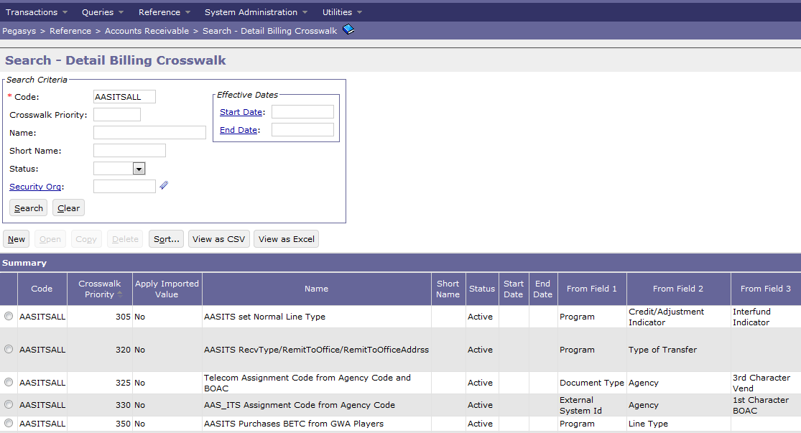
Crosswalk Maintenance Table
Crosswalk Rules:
Maintained on the Crosswalk Maintenance Table
Reference → Accounts Receivable → Detail Billing Crosswalk
Maintained by Central Office

Slide 60
Detail Billing Crosswalk Maintenance
Example Crosswalk Rules:
Transaction Type
Customer TSYM from ACRN
Assignment Code from Agency
Document Type from various fields (see following slide)
Detail Billing Crosswalk Options tab
Code: AASITSAUTO Priority: 115 Sequence: 1
From Fields:
1. External System ID
2. Program Dimension
3. Advance Indicator
To Fields:
1. Template Doc Type
2. Trans Type
3. Business Line
4. Receivable Type
5. Remit To Office
6. Remit To Office Address
Crosswalk Rule Group 1

Slide 61
Detail Billing Crosswalk Reference Table
Detail Billing Crosswalk Data Details: Define specific From and To field value rules using a flexible set of operators and flags
Detail Billing Crosswalk Options tab
Code: AASITSAUTO Priority: 115
Detail Billing Crosswalk Details tab
From Fields:
1. External System ID
2. Program Dimension
3. Advance Indicator
Sequence 1
Sequence 2
From Fields:
1. External System ID = NBA
2. Program Dimension = AA10
3. Advance Indicator = T
From Fields:
1. External System ID = RBA
2. Program Dimension = IT23
3. Advance Indicator = T
To Fields:
1. Template Doc Type
2. Trans Type
3. Business Line
4. Receivable Type
5. Remit To Office
6. Remit To Office Address
To Fields:
1. Template Doc Type = BAN
2. Trans Type = ADV
3. Business Line = AASFEDSIM
4. Receivable Type = AASITSADV
5. Remit To Office = AASITSNI
6. Remit To Office Address = AASITSNI_RMT
To Fields:
1. Template Doc Type = BAN
2. Trans Type = ADV
3. Business Line = ITSEXPSER
4. Receivable Type = AASITSADV
5. Remit To Office = AASITSNI
6. Remit To Office Address = AASITSNI_RMT

Slide 62
Detail Billing Crosswalk Reference Table
Detail Billing Crosswalk Batch Process:
AAS & ITS Crosswalk Batch Jobs:
Selects DBRs depending on whether they were automated or manually created
AAS/ITS Hybrid – AASDTBLXWLK
Manual = External System ID of EXPSERMANL, FEDSIMMANL, HSPD12MANL, IWACMANL, NATITCMMAN, or REGITMANL
Automated = External System ID of NBA or RBA
Telecom/WAN – TLCDTBLXWLK
Manual = External System ID of REGTELMANL or ITSWANMANL
Automated = External System ID of TOPS, WITS, or EMORRIS

Slide 63
Detail Billing Crosswalk Reference Table
Detail Billing Crosswalk Rules:
AAS, ITS, Telecom, and WAN Crosswalk Rules:
Rule Groupings are run in order of their priority - smallest to largest:
Depending on the External System ID, the below Rule Grouping will be executed:
AASITSAUTO (Priority 100s) for Automated DBRs, or
AASITSMANL (Priority 200s) for Manual DBRs
Rule Grouping AASITSALL (Priority 300s) will then be run for both Manual and Auto DBRs
Once a Rule Grouping is determined, it will be run based on priority order and sequence number order
Run
AASITSAUTO
Rule Grouping
Run
AASITSALL
Rule Grouping
Automated
or Manual?
Auto
AAS & ITS
Crosswalk
Batch Process
Manual
Run
AASITSMANL
Rule Grouping
Run
AASITSALL
Rule Grouping

Slide 64
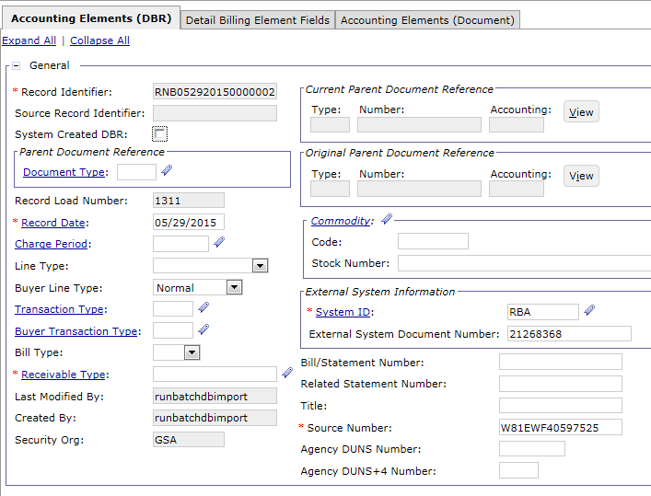
DBR – After Import, Before Crosswalk

Slide 65
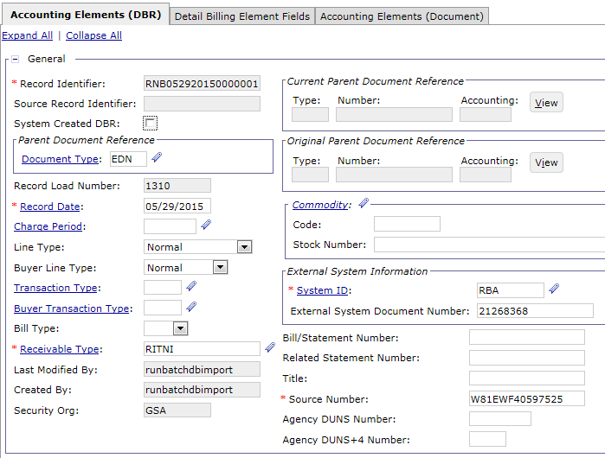
DBR – After Crosswalk

Slide 66
DBR Lifecycle
Detail Billing Record
Import
Detail Billing Record Crosswalk
Detail Billing Record Summarization
DBRs loaded into Pegasys via DBR Import
Detail Billing Records
For
IPAC | Non-IPAC | Internal Vouchers
Processed by
DBR IMPORT
Pegasys specific fields filled in by Crosswalk
Values in “From” Fields
Determines
Values in “To” Fields
Processed by
CROSSWALK
Like DBRs grouped to create BD or NV
Detail Billing Records
Are Grouped
By Identical values in specific fields creating Documents and Accounting Lines
Processed by
SUMMARIZATION

Slide 67
Summarization Batch Process
The Summarization process selects all non-associated (orphan) DBRs that are eligible and creates:
Billing Documents (BDs)
Internal Vouchers (NVs)
Summarization document processing:
DBRs selected by Summarization to create BDs and NVs become associated with the document and are no longer non-associated, or orphan, records
Documents missing required data will not process.
These forms are recorded in HELD status
Each document is created with a maximum of 250 Accounting Lines
If more than 250 Accounting Lines exist, a new document is created
DBR Import
DBR Crosswalk
DBR Summarization
Billing Documents and Internal Vouchers are created
Manually Add or Edit DBR

Slide 68
Summarization Batch Process
The Summarization batch process has the ability to
Create new BDs/NVs or
Update existing BDs/NVs
Create New = True
When the ‘Create New’ setting is set to True (T), the job will create new documents
Summarization will not correct existing documents
Summarization assigns Statement Numbers to new BD or NV transactions
Create New = False
When the ‘Create New’ setting is set to False (F), the job will try to find a matching document based on the shared fields to update
If Summarization cannot find a matching document, it will create a new document
DBR Import
DBR Crosswalk
DBR Summarization
Billing Documents and Internal Vouchers are created
Manually Add or Edit DBR

Slide 69
Summarization Batch Process – Create New BD/NV
Create New setting (True vs. False) varies depending on timing within the billing cycle
Example assuming billing month of July 2015:
A new billing file is submitted for processing in Pegasys for July 2015 billing
Create New is set to True when running Summarization on the first Billing file for a given month
Summarization will create new Billing Documents for all records in the Billing file as this is the first billing file for the month
Additional billing files are subsequently sent for July billing on a daily basis
Create New is set to False for all other executions of Summarization for July billing
Summarization will update existing BDs and NVs where possible and create new BDs and NVs as needed
Summarization will then be run with Create New set to True when the first Billing file for August is sent as this is the beginning of a new billing month
AAS – Summarization will then be run with Create New set to True after the previous billing cycle has run – not necessarily at the beginning of the next calendar month.

Slide 70
Summarization Results
DBRs are summarized onto either separate accounting lines or separate documents
Using select DBR fields (see following slide)
Document –
If two records have different values for elements that are document summarization criteria, the records will be summarized to different Billing Documents
If two records have the same values for elements that are document summarization criteria, the records will be summarized to the same Billing Document
Example: External System ID, Vendor
Accounting Line –
If two records have different values for elements that are AL summarization criteria, the records will be summarized to different accounting lines
If two records have the same values for elements that are AL summarization criteria, the records will be summarized to the same accounting line
Example: Fund, Activity

Slide 71
AAS Summarization Criteria
General Fields
External System ID*
Vendor Code
Designated Agent Code
Agency
Bureau
Billing Method
External System Document Number
Accounting Fields
Activity
BBFY
Region
Fund
Organization
Program
Revenue Source
System
Agreement Number
Agreement Line Number
Credit Indicator
Advance Indicator*
Period of Performance Start Date
Period of Performance End Date
Related Statement Number
Summarizes to New Document
Summarizes to New AL
*Distinguished via Crosswalk into distinct Document Types/Line Type
Please refer to the AAS Billing DES and for comprehensive Summarization Criteria information.

Slide 72
AAS Summarization Criteria
Interfund/Intrafund Fields
Interfund Indicator*
Reference Document Type
Reference Document Number
Reference Line Number
Mostly IPAC Fields
Accounting Classification Code
Accounting Classification Reference Number
Fiscal Station Number
Customer Sublevel Prefix
Customer Treasury Symbol: Allocation Transfer Agency
Customer Treasury Symbol: Agency Identifier
Customer Treasury Symbol: Beginning Period of Availability
Customer Treasury Symbol: Ending Period of Availability
Customer Treasury Symbol: Availability Type
Customer Treasury Symbol: Main Account
Customer Treasury Symbol: Sub Account
Agency DUNS
Agency DUNS+4
Funding Source
Summarizes to New Document
Summarizes to New AL
*Distinguished via Crosswalk into distinct Document Types/Line Type
Please refer to the AAS Billing DES and for comprehensive Summarization Criteria information.

Slide 73
Telecom Summarization Criteria
General Fields
External System ID*
Vendor Code
Designated Agent Code
Title
External System Document Number
Accounting Fields
Activity
BBFY
Region
Fund
Organization
Program
Revenue Source
Credit Indicator
Advance Indicator*
Period of Performance Start Date
Period of Performance End Date
Related Statement Number
Summarizes to New Document
Summarizes to New AL
*Distinguished via Crosswalk into distinct Document Types/Line Type
Please refer to the Telecom Billing DES and for comprehensive Summarization Criteria information.

Slide 74
Telecom Summarization Criteria
Interfund/Intrafund Fields
Interfund Indicator*
Reference Document Type
Reference Document Number
Reference Line Number
Mostly IPAC Fields
Accounting Classification Code
Accounting Classification Reference Number
Fiscal Station Number
Customer ALC
Customer Sublevel Prefix
Customer Treasury Symbol: Allocation Transfer Agency
Customer Treasury Symbol: Agency Identifier
Customer Treasury Symbol: Beginning Period of Availability
Customer Treasury Symbol: Ending Period of Availability
Customer Treasury Symbol: Availability Type
Customer Treasury Symbol: Main Account
Customer Treasury Symbol: Sub Account
Agency DUNS
Agency DUNS+4
Summarizes to New Document
Summarizes to New AL
*Distinguished via Crosswalk into distinct Document Types/Line Type
Please refer to the Telecom Billing DES and for comprehensive Summarization Criteria information.

Slide 75
Summarization Process
Unique Record ID
RNB07152013 0000001
Statement Number
HM000836
Document
HDNHM000836-001
Fiscal Station Number
0
Vendor
123008
Fund
285F
Region
02
Amount
$120
Unique Record ID
RNB07152013 0000002
Statement Number
HM000836
Document
HDNHM000836-001
Vendor
123008
Fiscal Station Number
0
Fund
285F
Region
04
Amount
$30
Unique Record ID
RNB07152013 0000003
Statement Number
HM000836
Document
HDNHM000836-001
Vendor
123008
Fund
285F
Region
04
Fiscal Station Number
0
Amount
$50
Fund
285F
Region
02
Fiscal Station Number
0
Unique Record ID
RNB07152013 0000001
Amount
$120
Statement Number
HM000836
Document
HDNHM000836-001
Vendor
123008
Unique Record ID
RNB07152013 0000002
Amount
$30
Fund
285F
Region
04
Fiscal Station Number
0
Unique Record ID
RNB07152013 0000003
Amount
$50

Slide 76
DBRs in Relation to BDs and NVs
Notes:
Explain relationship between Statement, document, Accounting Lines, and detail billing records

Slide 77
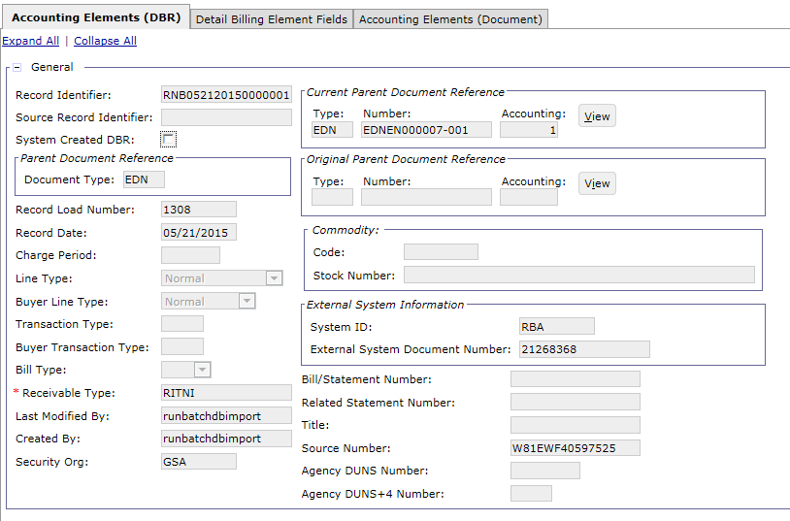
DBR – After Summarization
CGI Federal Proprietary and Confidential

Slide 78
Segment 3:
DBR Query

Slide 79
Table of Contents
Segment 1: Detail Billing Record (DBR) Overview and Key Concepts
Segment 2: DBRs and Associated Batch Processing
Segment 3: DBR Query
DBR Query Overview
DBR Query Details
Segment 4: AAS Agreements
Segment 5: Pegasys Billing Transactions Overview
Segment 6: DBR Billing Methods and Resulting Transactions
Segment 7: DBR Billing Processes
Segment 8: Advances
Segment 9: Accruals
Segment 10: Billing-Related Queries
Segment 11: Credit Management
Segment 12: Reports Related to DBR Billing
Segment 13: Mass Import

Slide 80
Detail Billing Record Query
The Detail Billing Record Query allows users to search for, manually enter new, and modify existing Detail Billing Records
Search
The Detail Billing Record Query provides the ability to search by:
Detail Billing Record Information:
Associated or non-associated DBRs
DBR IDs
DBR Detail Billing Elements
Additional DBR values
Document Information
Parent Document Type/Number for associated DBRs
Document Vendor values
Document Accounting Dimensions
Additional document values
Shared Values on DBRs vs. Billing Documents

Slide 81
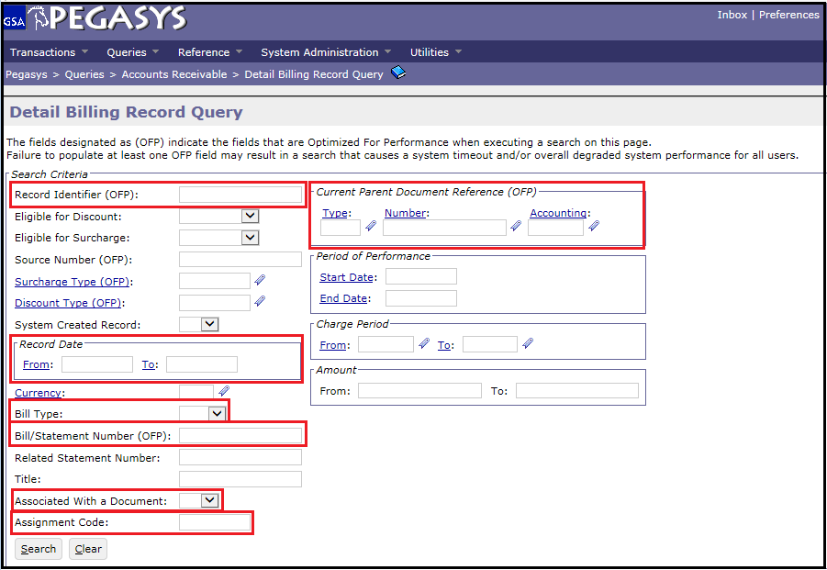
Detail Billing Record Query – Search
Pegasys → Queries → Accounts Receivable → Detail Billing Record Query
Note: Indexed parameters are marked with (OFP) and should be used to maximize performance when searching for DBRs
Indexed Parameters
Record Identifier- unique DBR Number
Current Parent Document Reference
Bill/Statement Number
Additional Search Criteria
Record Date From/To
Bill Type
Associated With a Document
Assignment Code
Notes:
Indexed parameters provide the quickest search results when queried. It is also good practice to include as many additional search criteria as possible in order to narrow down the DBR search.

Slide 82
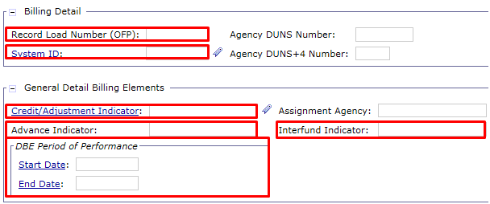
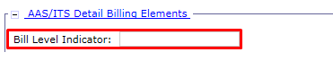
Detail Billing Record Query – Search
Indexed Parameters
Record Load Number – Each DBR Import Load is assigned its own Record Load Number
Additional Search Criteria
System ID – RBA, NBA, TOPS, WITS, EMORRIS, AASITSMANL
Credit/Adjustment Indicator – C (Credit), A (Adjustment), or blank
Advance Indicator – T (Advance DBR), O (Offset Notification DBR), or blank
Interfund Indicator – T (Interfund), A (Intrafund), or blank
DBE Period of Performance – Start Date and End Date
Bill Level Indicator – A, B, C, or blank
Notes:
Indexed parameters provide the quickest search results when queried. It is also good practice to include as many additional search criteria as possible in order to narrow down the DBR search.

Slide 83
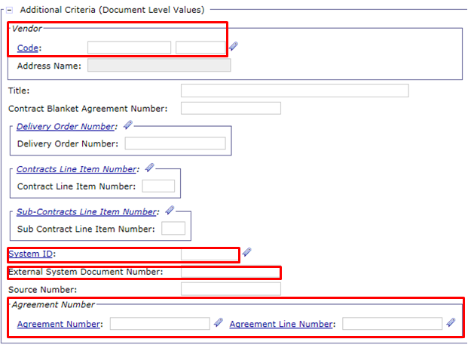
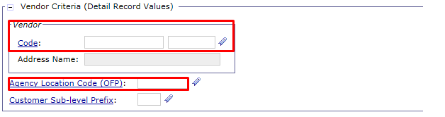
Detail Billing Record Query – Search
Indexed Parameters
Agency Location Code
Additional Search Criteria
Vendor Code (Document Level Values) – Vendor Code on associated DBRs
System ID (Document Level Values)
External System Document Number
Agreement Number and Agreement Line Number
Vendor Code (Detail Record Values) – Vendor Code on non-associated DBRs
Notes:
Indexed parameters provide the quickest search results when queried. It is also good practice to include as many additional search criteria as possible in order to narrow down the DBR search.

Slide 84
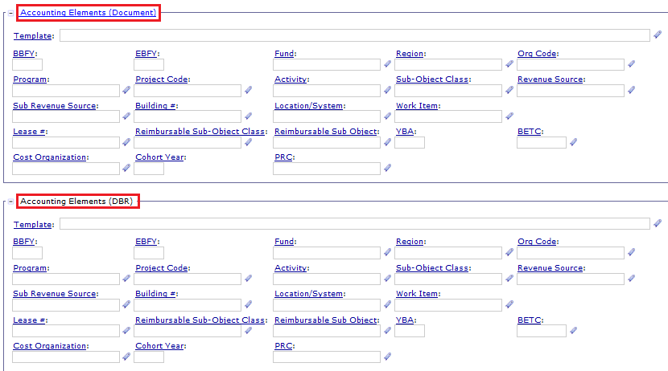
Detail Billing Record Query - Search
Additional Search Criteria
Accounting Elements (Document)
Accounting Elements (DBR)
Accounting Elements – Buyer (Detail Record Values)
Cost Organization (DBR)
Notes:
Indexed parameters provide the quickest search results when queried. It is also good practice to include as many additional search criteria as possible in order to narrow down the DBR search.

Slide 85
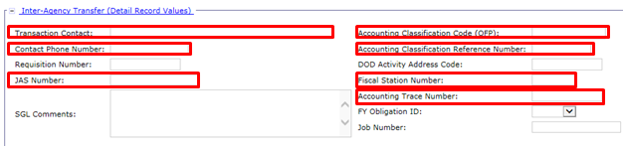
Detail Billing Record Query – Search
Indexed Parameters
Accounting Classification Code
Additional Search Criteria
Transaction Contact
Contact Phone Number
JAS Number
Accounting Classification Reference Number
Fiscal Station Number
Accounting Trace Number
Notes:
Indexed parameters provide the quickest search results when queried. It is also good practice to include as many additional search criteria as possible in order to narrow down the DBR search.

Slide 86
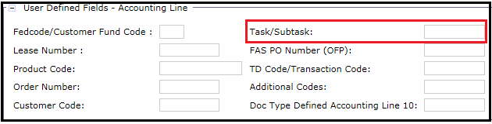
Detail Billing Record Query – Search
Additional Search Criteria
Task/Subtask
Notes:
Indexed parameters provide the quickest search results when queried. It is also good practice to include as many additional search criteria as possible in order to narrow down the DBR search.

Slide 87
Detail Billing Record Query – Manual Processes
Manually enter new
GSA users with appropriate security permissions can manually enter new Detail Billing Records
Detail Billing Records can be created from scratch, or from copying existing records and altering field values as needed
Detail Billing Records entered from within the Detail Billing Record Query are orphan (non-associated) records
Modify existing
Existing non-associated manually created or feeder system generated Detail Billing Records can be edited from within the Detail Billing Record Query (before Summarization)
Both shared and non-shared fields are available to be modified for non-associated records

Slide 88
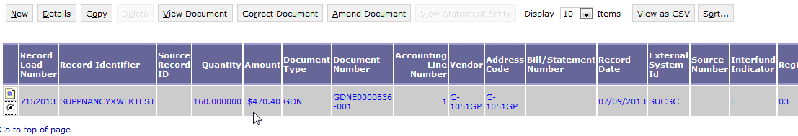
Detail Billing Record Query – Manually Enter New DBR
Manually enter new DBRs
Create New – From Scratch
Select New button
Populate all required fields on Detail Billing Record
Create New – Copy from existing and alter field values
Search for intended Detail Billing Record to Copy
Select item from Item Collection
Select Copy button

Slide 89
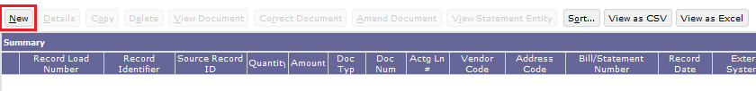
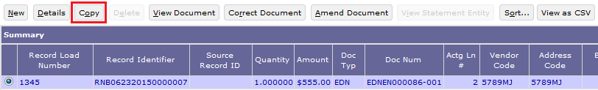
Detail Billing Record Query – Create New
Create brand-new DBR
Queries → Accounts Receivable → Detail Billing Record Query → New
Create new DBR by copying an existing DBR
Queries → Accounts Receivable → Detail Billing Record Query → Search for existing DBR → Copy
DBRs created by copying are unassociated, or orphans.
DBRs created by copying do not inherit:
Record Identifier
Document Reference information
Record Load Number

Slide 90
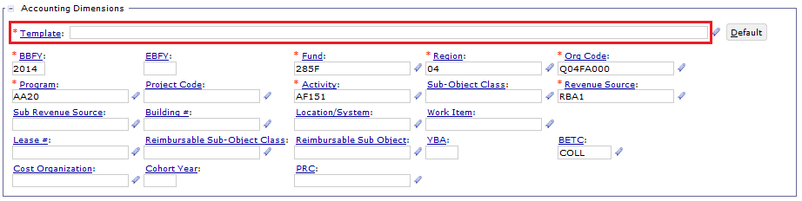
Detail Billing Record Query – Create New
DBRs created by copying do inherit Accounting Dimensions, but also require an Accounting Template

Slide 91
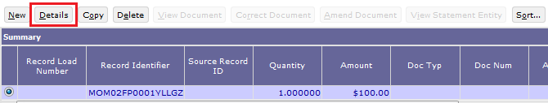
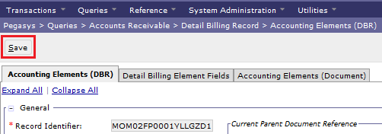
Detail Billing Record Query – Modify Existing
Modify existing DBR
Pegasys → Queries → Accounts Receivable → Detail Billing Record Query → Search for existing DBR → Details
Make modifications → Save

Slide 92
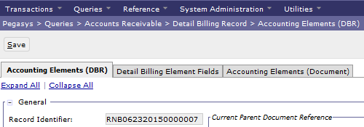
Detail Billing Record Query – Detail
DBR Query details – 3 tabs:
Accounting Elements (DBR) tab
Detail Billing Element Fields tab
Account Elements (Document) tab

Slide 93
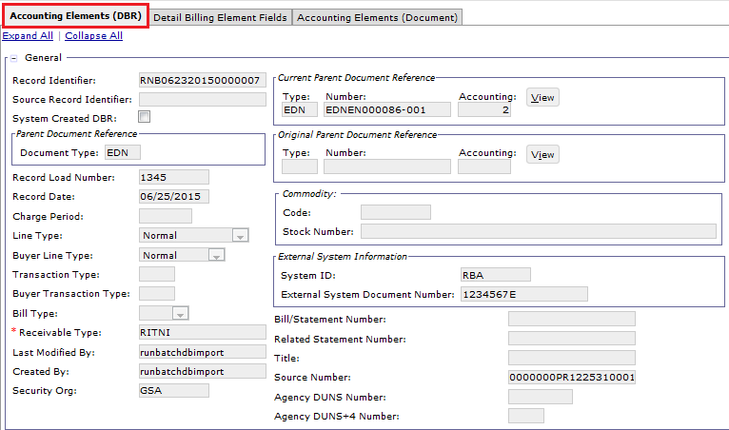
Detail Billing Record Query - Detail
Accounting Elements (DBR) tab
Contains the original values of the shared fields of the Detail Billing Record (the value stored on the Detail Billing Record Table)
Example: External System ID, Vendor Code, Receivable Type

Slide 94
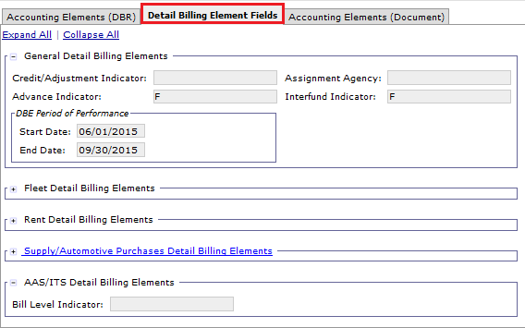
Detail Billing Record Query - Detail
Detail Billing Element Fields tab
Contains the Detail Billing Record specific fields, the non-shared fields
Example: Credit/Adjustment Indicator, Advance Indicator, Bill Level Indicator

Slide 95
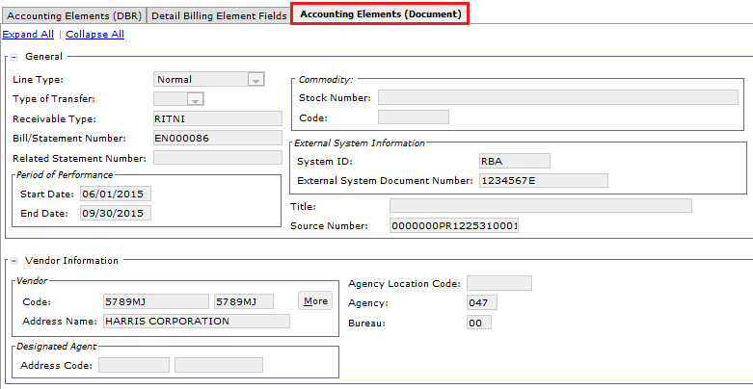
Detail Billing Record Query – Detail
Accounting Elements (Document) tab
Document Level Values are populated when Summarization is complete
Contains the current values of the Shared Fields of the Detail Billing Record (the value stored on the Associated document if applicable)
Example: Accounting Dimensions, Vendor Code, Receivable Type

Slide 96
Exercise 1
Exercise 1 – Review DBR on DBR Query

Slide 97
Segment 4:
AAS Agreements

Slide 98
Table of Contents
Segment 1: Detail Billing Record (DBR) Overview and Key Concepts
Segment 2: DBRs and Associated Batch Processing
Segment 3: DBR Query
Segment 4: AAS Agreements
AAS Agreements
Segment 5: Pegasys Billing Transactions Overview
Segment 6: DBR Billing Methods and Resulting Transactions
Segment 7: DBR Billing Processes
Segment 8: Advances
Segment 9: Accruals
Segment 10: Billing-Related Queries
Segment 11: Credit Management
Segment 12: Reports Related to DBR Billing
Segment 13: Mass Import

Slide 99
Billing Vehicles – DBR/PCAS Hybrid
Billing Vehicle describes:
The method/processes used by GSA to generate customer billing transactions within Pegasys
Can utilize all 3 Billing Methods (IPAC, non-IPAC, Internal)
Phase 3 Billing Vehicles – Automated:
Detail Billing Records (DBRs)
Project Cost Accounting System (PCAS)
DBR/PCAS Hybrid
Phase 3 Billing Vehicles – Manual:
Non-PCAS/Non-DBR

Slide 100
DBR/PCAS Hybrid Overview
DBR/PCAS Hybrid – uses elements from both PCAS and DBR billing vehicles
DBR/PCAS Hybrid billing vehicle allows GSA to:
Via the Agreement:
Define the terms and conditions for GSA to provide goods/services to its customer via Pegasys Agreements
Track fulfillment of customer orders (UFCO) by GSA for internal and external customers
Track billing and collections for goods/costs/services
Via the DBR:
Record billing detail documenting the goods or services provided
Generate Pegasys billing transactions (receivable/revenue)

Slide 101
Billing Vehicles – AAS
Assisted Acquisition Services (AAS) Business Lines
All AAS business lines will use the DBR/PCAS Hybrid billing vehicle
Business Line Name | Pegasys Business Line Value
RBA:
Regional Assisted Acquisition Services | AASREGIT
Integrated Workplace Acquisition Center | IWAC
Regional Network Services - Expanded Services | ITSEXPSER
National IT Commodity Program | ITSNATITCM
NBA:
National Assisted Acquisition Services | AASFEDSIM
HSPD-12 | ITSHSPD12

Slide 102
DBR/PCAS Hybrid Lifecycle
Establish Agreement
Initiate Billing Records at Feeder System
Establish Detail Billing Records in Pegasys
Generate Receivable and /or Advance Offset
Record Accrual
Record Collection
Disputes/
Chargebacks
Process Write off/ Adjustment/ Treasury Referral
Bill Customer
Track Receivable & Record Overdue Charges
Agreement Interface
Pegasys Connect
FMESB
DBR Import
DBR Crosswalk
DBR Summarization
IPACIN
LOCKBOX
Pay.Gov via CIR
Manual
AROVERDUE
ARDUNNING
Accrual Interface
Mass Import
Manual Creation
Credit Application
IPACOUT
ARBILLGEN
Not all steps will apply to every Receivable. These are potential events in the Accounts Receivable (AR) Life Cycle.
ARREFERSEL
ARTREOEX
IPACIN
AREOCOLL
IPACIN
Pay.gov via CIR
CGI Federal Proprietary and Confidential

Slide 103
PCAS Overview and Key Concepts
Pegasys Project Cost Accounting System (PCAS) module:
Provides for management of costs/revenues through use of “Agreements”
PCAS Agreement:
Define terms/conditions regarding the provision of goods/services by GSA to a customer
Record the amount of funding a customer agrees to provide to GSA in exchange for goods/services
Track fulfillment of customer orders by GSA for the customer
Agreements provide an automated means of:
Tracking spending for procurement of goods and services
Billing the customer for goods/services rendered
Tracking customer reimbursements for goods/costs/services
PCAS (Agreement)
Receivables (Billing)
Collections
CGI Federal Proprietary and Confidential

Slide 104
PCAS Agreement Overview
PCAS Agreement – constitutes a written order from the customer requesting GSA to procure goods and services on its behalf
Pegasys Agreement Entity:
Tracks all Pegasys transaction referencing the Agreement
Provides detailed information for each transaction, including:
Advances, spending (i.e. costs incurred to fill customer order), surcharges, receivables, and collections
Established by processing a Pegasys Agreement Document
Pegasys Document Categories:
ED – External Direct Agreement for external customers
ID – Internal Direct Agreement for internal customers

Slide 105
PCAS Agreement Overview
Pegasys Agreement Entity:
Agreement terms can be updated by:
Processing a new Document with the original Agreement Number to update the entity

Slide 106
Agreement Attributes
Customer Type:
Internal
External
Federal
Non-Federal
Billing Method
IPAC
Standard/Non-IPAC
Interfund/Intrafund
Billing Model
Recurring
Spending-Based
DBR/PCAS Hybrid
Agreements in Pegasys can be categorized by various attributes, including:
Customer Type
Billing Method
Billing Model

Slide 107
Customer Type – External vs. Internal
External Direct Agreement (ED)
Used when GSA enters into an Agreement with an entity outside the agency (Federal, state, private company/individual)
Two types of transactions are used to record revenue for an External Direct Agreement:
Billing Documents
Advance Offsets (CR) if payment is funded by Advance Payment (CR)
GSA
DoD
California State Gov
EPA
…………………………………………………….......
GSA
PBS
OGP
OCSIT
FAS
Internal Direct Agreement (ID)
Used when GSA enters into an Agreement with another service/office/business line within GSA
Used to generate Internal Vouchers to simultaneously record expense for the buyer and revenue for the seller
CGI Federal Proprietary and Confidential

Slide 108
External Customer Type – Federal vs. Non-Federal
Federal and Non-Federal Agreements are distinguished via the Vendor Code associated with the Agreement
Agreements
External
Internal
Federal
Non-Federal
Requires Advance CR
Federal Agreement:
When an Agreement is established between GSA and a Federal customer, GSA can fill the customer order immediately
Federal customer Agreements do NOT require an Advance Collection
Non-Federal Agreement:
When an Agreement is established between GSA and a Non-Federal customer, GSA must wait for the customer to provide a monetary Advance before the customer order can be filled
Advance created as a Cash Receipt with an Advance Payment line type
CGI Federal Proprietary and Confidential
Notes:
**Examples of some of the larger Non-Federal clients GSA has: state governments and large metropolitan areas and key cities

Slide 109
Billing Methods
Billing Method by Customer Type:
External Agreements:
Federal:
IPAC or Standard (Non-IPAC)
Non-Federal:
Standard (Non-IPAC)
Internal Agreements:
Interfund/Intrafund
Agreements
External
Internal
Interfund/Intrafund
Federal
IPAC / Standard
Non-Federal
Standard
CGI Federal Proprietary and Confidential

Slide 110
Billing Models
There are 3 types of Pegasys PCAS billing models:
Recurring – Pre-established Flat Rate per billing period
Not used by AAS/ITS business lines
Spending-Based – Based on costs incurred referencing Agreement:
Actual Spending
Agreement Charges
Not used by AAS/ITS business lines
DBR/PCAS Hybrid – Based on DBRs received from RBA/NBA feeder systems referencing the agreement
DBRs are imported/crosswalked/summarized to create Billing Documents and Internal Vouchers referencing the agreement
CGI Federal Proprietary and Confidential
Notes:
The Agreement can be set up to bill the customer based on a Flat Rate or Percentage, or be billed based on costs

Slide 111
AAS Agreement Overview
AAS Agreements are:
External and Internal customers
External: Federal and Non-Federal customers
Semi-monthly (2x per month) amounts billed via the DBR/PCAS Hybrid billing vehicle
Automated creation of agreements via new AAS Agreement Interface
Maintained using a real-time, web service-based interface between AAS ASSIST Module and Pegasys
Source systems:
Regional Business Application (RBA)
National Business Application (NBA)
Notes:
.

Slide 112
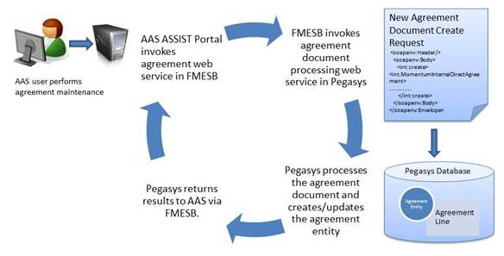
AAS Agreement Interface

Slide 113
AAS Agreement Document Types
AAS Agreement Document Types
Document Type | Purpose
UED | External Direct Agreement
UID | Internal Direct Agreement
CGI Federal Proprietary and Confidential

Slide 114
AAS/ITS Agreement Attributes
Billing Methods:
Non Federal – Non-IPAC
Federal – IPAC/Non-IPAC/Interfund
Billing Vehicle:
Bills generated via DBR/PCAS Hybrid Model
Bills generated twice a month
Bills generated via DBRs (not PCAS batch processing)
Advance Offsets (low volume)
Receivables Lifecycle:
DBR/PCAS Hybrid Receivables Lifecycle is used to support the processing of AAS and associated transactions

Slide 115
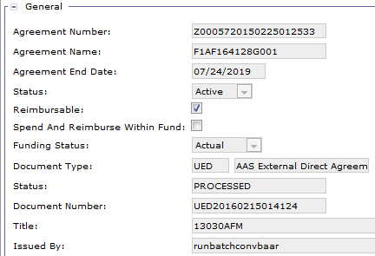
AAS/ITS Settings: Header – General
Business Line | AAS/ITS
Agreement Number | RBA - “X” + unique generated agreement number NBA - “Z” + unique generated agreement number
Agreement Name | Funding document number for this agreement
Status | Active
Business Line | AAS/ITS
Agreement End Date | Enter end date of Agreement (Required)
Reimbursable | True
Spend and Reimburse within Fund | False
Funding Status | Actual

Slide 116
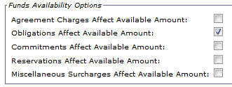
AAS/ITS Settings: Header – Funds Availability
Business Line | AAS/ITS
Agreement Charges Affect Available Amount | unchecked
Obligations Affect Available Amount | checked
Commitments Affect Available Amount | unchecked
Reservations Affect Available Amount | unchecked
Miscellaneous Surcharges Affect Available Amount | unchecked

Slide 117
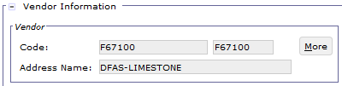
AAS/ITS Settings: Header – Vendor
Business Line | AAS/ITS
Vendor Code | Required – BOAC2 Code

Slide 118
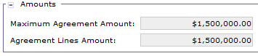
AAS/ITS Settings: Header – Amounts
Business Line | AAS/ITS
Maximum Agreement Amount | Maximum total billable amount for the life of the Agreement.
Total Agreement Line Amounts | Read Only. Aggregate dollar value of all Accounting Line amounts.

Slide 119
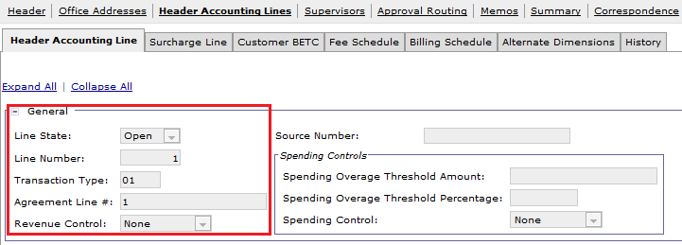
AAS/ITS Settings: Accounting Line – General
Business Line | AAS/ITS
Line Status | Open
Line Number | 1
Transaction Type | 01
Agreement Line | 1
Revenue Control | None

Slide 120
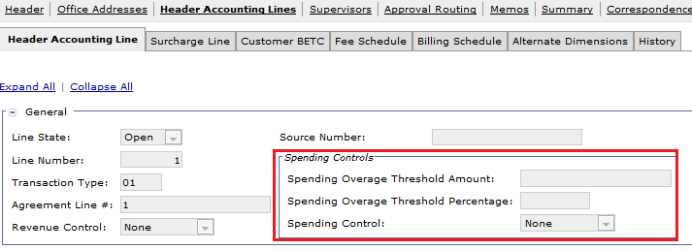
AAS/ITS Settings: Spending Controls
Business Line | AAS/ITS
Spending Overage Threshold | Blank
Spending Overage Threshold Percentage | Blank
Spending Controls | None

Slide 121
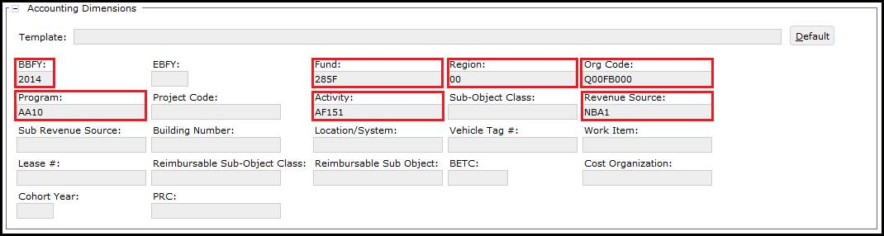
AAS/ITS Settings: Accounting Dimensions
Business Line | AAS/ITS
BBFY | Fiscal year corresponding to the agreement start date
Fund | 285F
Region | Two digit region code (valid values 00-11)
Org Code | 8-character code where positions two and three are equal to the two-digit Region Code (e.g., Q01FB000)
Program | 4-digit program code (e.g., AA10)
Activity | AF151
Revenue Source | “NBA1” if the Program Code is AA10 or IT31 “RBA1” if the Program Code is AA20, GS14, IT14, or IT23

Slide 122
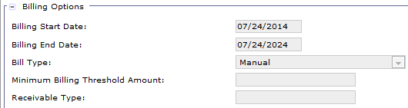
AAS/ITS Settings: Billing Options
Business Line | AAS/ITS
Bill Start Date | Required
Bill End Date | Required
Bill Type | Defaults to Manual for AAS/ITS Agreements

Slide 123
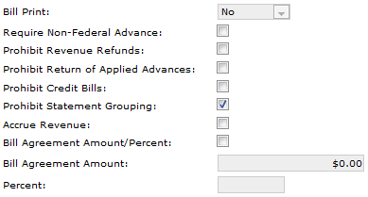
AAS/ITS Settings: Billing Options
Business Line | AAS/ITS
Bill Print | Set to No
Prohibit Revenue Refunds | Defaults to False
Prohibit Statement Grouping | Defaults to True
Bill Agreement Amount/Percent | Set to False
Bill Agreement Amount | Leave blank

Slide 124
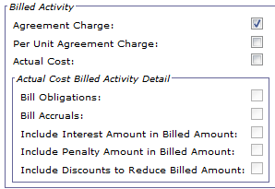
AAS/ITS Settings: Billed Activity
Business Line | AAS/ITS
Agreement Charge | checked
Per Unit Agreement Charge | unchecked
Actual Cost | unchecked
Bill Obligations | unchecked
Bill Accruals | unchecked

Slide 125
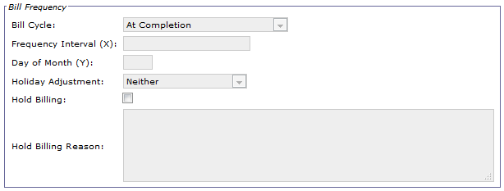
AAS/ITS Settings: Bill Frequency
Business Line | AAS/ITS
Bill Cycle | Set to At Completion
Frequency Interval (X) | Leave blank
Day of Month (Y) | Leave blank

Slide 126
Agreement Query
Agreement Entity:
Tracks unfilled customer orders, advances, spending, surcharges, receivables, and collections via Pegasys transactions referencing the Agreement
Note that AAS agreements will only be used to track unfilled customer orders, advances, receivables, and collections
Represents the cumulative effect of all transactions processed against the Agreement
Agreement Query:
Summary of all activity against the customer Agreement and a detailed transaction history for the Agreement Entity
Breakdown of revenue including Receivables, Collections, Credits, Advances and Write-Offs
Can be searched at the Agreement Header Level or Accounting Line Level
Notes:
Provides a breakdown of revenue including Receivables, Collections, Credits, Advances and Write-Offs
Comment from R7 - R7 will focus be on the revenue

Slide 127
Agreement Query
The Agreement Query provides:
Summary of the Agreement Entity itself
View Agreement Documents used to:
Generate the Agreement Entity (the original Agreement document)
Update the Agreement Entity after original Agreement document processed
Summary of all billing/collection activity processed against the Agreement
View summarized billing/collection amounts referencing the Agreement
View individual billing/collection transactions referencing the Agreement

Slide 128

Agreement Query – Search
Notes:
As we move through the slides, we will discuss how each action updates the Agreement entity/query

Slide 129

Agreement Query – General
Activity Log – Lists billing and collection transactions referencing the Agreement
For NBA business lines, also lists accruals referencing the agreement
Surcharges – Not used by AAS business lines
History – Displays the history of the Agreement, including Agreement documents processed to increase/decrease the Agreement amount or make other changes

Slide 130

Agreement Query – Amount Summary

Slide 131



Agreement Query – Activity Log
Activity Log button – Allows users to search for and view all billing/collection-related transactions referencing the Agreement

Slide 132


Agreement Query – History
History button:
Displays the original ED/ID document that established the Agreement as well as any subsequent ED/IDs that have updated the Agreement entity
Refresh button:
Refresh amounts displayed on Agreement since the last time the Agreement entity was opened or refreshed

Slide 133

Agreement Query – Attachments
Attachments
Attachments can be added directly to the Agreement entity via the Agreement Query

Slide 134

Agreement Query – Add Attachments
Select Attachments Button
Select ‘Import Local File’
Enter Required and relevant fields
Select ‘Browse’ and choose file
Select ‘Upload’
Select ‘Return’

Slide 135

Agreement Query – Add Attachments
Notes:
Fill in required fields marked with astrix, click Browse. Pop up window comes up. choose file, click open. When finished, click Upload

Slide 136
Exercise 2
Exercise 2 – Review AAS Agreement on Agreement Query

Slide 137
Segment 5:
Pegasys Billing Transactions Overview

Slide 138
Table of Contents
Segment 1: Detail Billing Record (DBR) Overview and Key Concepts
Segment 2: DBRs and Associated Batch Processing
Segment 3: DBR Query
Segment 4: AAS Agreements
Segment 5: Pegasys Billing Transactions Overview
Billing Documents (BDs)
Statements
Internal Vouchers (NVs)
Segment 6: DBR Billing Methods and Resulting Transactions
Segment 7: DBR Billing Processes
Segment 8: Advances
Segment 9: Accruals
Segment 10: Billing-Related Queries
Segment 11: Credit Management
Segment 12: Reports Related to DBR Billing
Segment 13: Mass Import

Slide 139
Billing Document (non-IPAC and IPAC)
Billing Document (BD) - Performs two billing related functions:
Facilitates billing for services rendered or goods delivered
Records the financial impact of providing goods/services to external customers:
General Ledger impact: Accounts Receivable and Revenue
Two types of Billing Documents processed coinciding with the billing methods used by GSA’s Phase 3 business lines:
Non-IPAC
IPAC
Line Types (default to Normal for all Billing Documents)
Normal – used to recognize revenue
Credit – allows the recording of a liability
Advance – used to perform billing in advance of rendering goods/services
Attachments can also be added to documents

Slide 140

Billing Document – Header
Document Number – Assigned by the system when the Summarization batch job is executed
Bill Generated Flag – Indicates whether or not the bill has been generated. Only viewable after document has processed
Business Line – AASFEDSIM, AASREGIT, ITSEXPSER, ITSHSPD12, ITSNATITCM, ITSREGTEL, ITSWAN, or IWAC
Vendor Information – Code, Address Code, and Name of the customer

Slide 141


Billing Document – Accounting Line
Line Type – Indicates the type of transaction recorded on the accounting line
Billing Status – Billed or Unbilled
Transaction Type – Alphanumeric code used in combination with the transaction’s document type to infer General Ledger postings
Receivable Type – Used by flexible definitions as well as batch processes
Bill Print – Determines if this bill is printed or is suppressed

Slide 142
Billing Documents – Accounting Line
All AAS BDs must have Agreement Number and Agreement Line Number information
This reference will cause updates to the Agreement Entity to occur dynamically as documents are processed

Slide 143

Credits
Credits refer to money owed by GSA back to the customer and may be generated due to:
Rate changes
Exemptions
Billing Errors - resolution of disputes/chargebacks
Credits are recorded in Pegasys using Billing Document 'Credit' Line Type
Credits can be generated for all billing methods:
Non-IPAC
IPAC
Interfund/Intrafund
Note: Pegasys supports negative Internal Voucher (NV) accounting lines to record Interfund/Intrafund credits

Slide 144
Credits
Credits are created:
Automatically via the Summarization Batch Process (i.e., summarizing credit Detail Billing Records from feeder systems and generating Billing Documents with “Credit” line type)
Manually (i.e., creating a Billing Document with “Credit” line type)
Via the Credit Application Worksheet and Automated Credit Application Batch Process, Credits can be:
Applied against another bill or the current bill
Refunded to the customer
Transferred to Treasury
Credits will be discussed in detail in Segment 10, Credit Management

Slide 145


Billing Document – Office Addresses
The Office Addresses tab records the applicable GSA Remit To office address information (Office Type, Office, Office Address)
Office Type
Address
The Remit to Office information is presented to the customer on the PDF statement in VCSS

Slide 146

Billing Document – Detail Billing Record Search
Associated DBRs can be identified on the Detail Billing Record Search Tab
Existing Detail Billing Records can be searched for and viewed
Add - new DBRs can be created

Slide 147

Billing Document – Modified Detail Billing Record
The Modify Detail Billing Records tab can be used to add or change DBRs in a Billing Document’s Correct or Amend mode
Actions:
Add – Create new DBR on BD
Copy – Copy existing DBR on BD
Disassociate – Remove DBR from BD

Slide 148
Billing Document – Attachments
GSA users can add attachments:
Added directly to the document
For internal use
To add an attachment:
If not within document - navigate to document:
Pegasys → Transactions → Form/Document Selection
Enter query criterion (be as detailed as possible in order to maintain system integrity)
Select item and select ‘Correct’ or ‘Amend/Modify’
Within document:
Select Attachments Button
Select ‘Import Local File’
Enter required and relevant fields
Select ‘Browse’ and choose file
Select ‘Upload’

Slide 149


Billing Document – Attachments
Notes:
Click attachments button. This is what screen looks like

Slide 150


Billing Document – Attachments
Notes:
Fill in required fields marked with astrix, click Browse. Pop up window comes up. choose file, click open. When finished, click Upload

Slide 151


Billing Document – Non-IPAC
Non-IPAC Vendor on Header
Non-IPAC Remit To address
Blank Interagency Transfer information on Accounting Line

Slide 152
Billing Document – Non-IPAC – Document Types
Billing Vehicle: Standard DBR
Business Line | Document Type | Name
ITSWAN | WDN | Wide Area Network Non-IPAC BD
ITSWAN | WMN | Wide Area Network Manual Non-IPAC BD
ITSREGTEL | TDN | Telecom Non-IPAC BD
ITSREGTEL | TMN | Telecom Manual Non-IPAC BD

Slide 153
Billing Document – Non-IPAC – Document Types
Billing Vehicle: DBR/PCAS Hybrid
Business Line | Document Type | Name
AASFedSim | SDN | FEDSIM Non-IPAC BD
AASFedSim | SMN | FEDSIM Manual Non-IPAC BD
AASREGIT | EDN | Regional Assisted Acquisition Services Non-IPAC BD
AASREGIT | EMN | Regional Assisted Acquisition Services Manual Non-IPAC BD
IWAC | KDN | Integrated Workplace Acquisition Center Non-IPAC BD
IWAC | KMN | Integrated Workplace Acquisition Center Manual Non-IPAC BD
ITSEXPSER | XDN | Regional Network Expanded Services Non-IPAC BD
ITSEXPSER | XMN | Regional Network Expanded Services Manual Non-IPAC BD
ITSHSPD12 | HDN | HSPD-12 Non-IPAC BD
ITSHSPD12 | HMN | HSPD-12 Manual Non-IPAC BD
ITSNATITCM | NDN | National IT Commodity Program Non-IPAC BD
ITSNATITCM | NMN | National IT Commodity Program Manual Non-IPAC BD
Advances | BAN | AAS-ITS Advance BD
Advances | BAO | AAS-ITS Advance Offset Notification BD

Slide 154
Billing Document – IPAC
IPAC Billing Documents:
IPAC Billing Documents are generated for customers configured in Pegasys to use IPAC
IPAC Statements are generated via PDF and can be viewed from Pegasys and VCSS
Similar to Non-IPAC Billing Documents, except:
IPAC Billing Documents contain ‘Articles’:
Capture commodity/unit information, quantity, and unit price
Transmit this information to IPAC to be viewable on the customer’s IPAC record
Document the transaction's IPAC Status
Used to determine the state of the IPAC transaction within the IPAC lifecycle
Children of the Accounting Line
IPAC Statements provide the ability to group many Billing Documents together to bill customers in one consolidated bill at the ALC level
NOTE: AAS and WAN do NOT group by ALC
One agreement per statement, even if the agreement vendors share the same ALC

Slide 155

Billing Document – IPAC
Inter-Agency Transfer Section:
IPAC Bills - designated as IPAC by:
Inter-Agency Flag (checked) on BD header, AND
Type of Transfer (set to IPAC)
Interagency flag, Type of Transfer, Use Statement Number for IPAC, IPAC Article Qty/Unit Price Indicator are defaulted when an IPAC document type is selected
Region Standard DBR Business Lines and Hybrid DBR/PCAS Business Lines will use IPAC Article Qty/Unit Price Indicator = Use BDE Detail

Slide 156
Billing Document – IPAC – Articles
IPAC Billing Documents contain ‘Articles’:
Capture commodity/unit information, quantity, and unit price
Transmit this information to IPAC to be viewable on the customer’s IPAC record
Document the transaction's IPAC Status
Used to determine the state of the IPAC transaction within the IPAC lifecycle

Slide 157

Billing Document – IPAC – Articles
Qty/Unit Price Indicator – Indicates the configuration of the summation of article quantity and unit price when the IPAC BD accounting line has associated detail billing records
Article Amount – Calculated based on Quantity and Unit Price Amount
IPAC Status – State of the IPAC transaction within the IPAC lifecycle
Articles or Services – Items or services for which the user is billing the customer agency

Slide 158
Billing Document – IPAC – Document Types
Billing Vehicle: Standard DBR
Business Line | Document Type | Name
ITSWAN | WDI | Wide Area Network IPAC BD
ITSWAN | WMI | Wide Area Network Manual IPAC BD
ITSREGTEL | TDI | Telecom IPAC BD
ITSREGTEL | TMI | Telecom Manual IPAC BD

Slide 159
Billing Document – IPAC – Document Types
Billing Vehicle: DBR/PCAS Hybrid
Business Line | Document Type | Name
AASFedSim | SDI | FEDSIM IPAC BD
AASFedSim | SMI | FEDSIM Manual-IPAC BD
AASREGIT | EDI | Regional Assisted Acquisition Services IPAC BD
AASREGIT | EMI | Regional Assisted Acquisition Services Manual IPAC BD
IWAC | KDI | Integrated Workplace Acquisition Center IPAC BD
IWAC | KMI | Integrated Workplace Acquisition Center Manual IPAC BD
ITSEXPSER | XDI | Regional Network Expanded Services IPAC BD
ITSEXPSER | XMI | Regional Network Expanded Services Manual IPAC BD
ITSHSPD12 | HDI | HSPD-12 IPAC BD
ITSHSPD12 | HMI | HSPD-12 Manual IPAC BD
ITSNATITCM | NDI | National IT Commodity Program IPAC BD
ITSNATITCM | NMI | National IT Commodity Program Manual IPAC BD

Slide 160

Agreement – Before Billing Document

Slide 161

Agreement – After Billing Document
After Billing Document of $790
$790 + $790 = $1,580

Slide 162
Statements
A Statement is a high level entity that is generated when Billing Documents are processed by PCPROJBILL or SUMMARIZATION
GSA bills customers at the Statement level
Statements provide the ability to group multiple Billing Documents for the same customer in order to generate a single customer billing
The Statement Number is used by the customer to identify their Statement
The Billing Statement Query provides the ability to view:
Statement-Level Balances
Related BD (Billing Document) Balances
Vendor Balances
Notes:
Statement numbers can also be assigned at the time of manual form creation, using the generate Statement number button.

Slide 163

Statements
Statements:
Top level entity that is generated when Billing Documents are initially processed by Summarization or manual creation
GSA bills customers at the Statement level

Slide 164

Statements
Statements provide the ability to group multiple Billing Documents for the same customer in order to generate a single customer billing
Statement entity
Generated by Summarization when the BD transactions are created
Associates all related Billing Documents within the entity when generating the PDF statement
The Statement Number identifies the customer statement

Slide 165

Statement Numbers
Pegasys-generated statement numbers:
Pegasys generates a new Statement Number during Summarization for DBRs that do not contain a feeder system-assigned Statement Number
Pegasys determines the Statement Number via the pre-defined statement number formats configured for each business line/billing method
Statement Number is then used as summarization criteria by Summarization
A new BD will be created using the same Statement Number if the number of Accounting Lines on the document exceeds 250 Accounting Lines
Statement Numbers automatically generated by Pegasys upon document creation
Statement Number becomes embedded within Pegasys Document Number

Slide 166
Statement Number Formats – RBA/NBA Business Lines
Business Line | Interfaced / Manual DBRs | Document Types | Statement Number Format
AASFedSim | Interfaced | SDN/SDI | ‘SI’ + ######
AASFedSim | Manual | SMN/SMI | ‘SM’ + ######
AASREGIT | Interfaced | EDN/EDI | ‘EI’ + ######
AASREGIT | Manual | EMN/EMI | ‘EM’ + ######
IWAC | Interfaced | KDN/KDI | ‘KI’ + ######
IWAC | Manual | KMN/KMI | ‘KM’ + ######
ITSEXPSER | Interfaced | XDN/XDI | ‘XI’ + ######
ITSEXPSER | Manual | XMN/XMI | ‘XM’ + ######
ITSHSPD12 | Interfaced | HDN/HDI | ‘HI’ + ######
ITSHSPD12 | Manual | HMN/HMI | ‘HM’ + ######
ITSNATITCM | Interfaced | NDN/NDI | ‘NI’ + ######
ITSNATITCM | Manual | NMN/NMI | ‘NM’ + ######
Notes:
###### can be alpha-numeric for DBRs sent in via interface.
Some converted unbilled statements from RBA/NBA will use a converted format of pMC##### where p is a prefex determined by the business line as noted above.

Slide 167
Statement Number Formats – TOPS/WITS/E-MORRIS Business Lines
Business Line | Billing Method | Document Types | Statement Number Format
ITSWAN | Non-IPAC | WDN/WMN | ‘ZN’ + ######
ITSWAN | IPAC | WDI/WMI | ‘ZI’ + ######
ITSREGTEL | Non-IPAC | TDN/TMN | ‘U’ + #######
ITSREGTEL | IPAC | TDI/TMI | ‘T’ + #######

Slide 168
Billing Statement Query
The Billing Statement Query provides the ability to view:
Statement-Level Balances
Related BD (Billing Document) Balances
Vendor Balances
Statement Level Correspondence
Communication specifically related to a Statement in Pegasys
Attachments/PDF Bills
Sample search criteria include:
Statement Number
Vendor/Vendor Address Code and/or Designated Agent Code related to the Statement
Business Line
Collection Due Date
Last Statement Print Date
Statement Query will be discussed in detail in Segment 9, Billing-Related Queries

Slide 169
Internal GSA Billing
Internal billing transactions are recorded via Internal Vouchers in Pegasys
Internal Voucher (NV) –
Simultaneously records:
Revenue and increase to Cash for the seller
Expense and decrease to Cash for the buyer
Records seller and buyer side transaction information:
Accounting Dimensions
Transaction Types

Slide 170
Internal GSA Billing
The Internal Voucher (NV) is used to perform fund transfers to facilitate billing amongst organizations within GSA
Internal Vouchers (NVs):
The NV is located within the Accounts Payables module of Pegasys, but has both Payable and Receivable capabilities
Internal Vouchers require that a user specifies both buyer and seller accounting dimensions and Transaction Type, documenting both the receiver and provider of goods or services
Interfund vs. Intrafund:
Interfund transactions occur when one GSA Treasury Account Symbol (TSYM) bills another GSA TAS (e.g., 255F paying rent to 192X)
Intrafund transactions occur when the same, single GSA TSYM bills itself
Notes:
For Imputed Rent Phase 1 SVs or Standard Vouchers were used to record internal billing. Do not confuse DoD Interfund with Internal Interfund.

Slide 171

Internal Voucher – Header
Disbursing Office – Identifies the office that will disburse the given replenishment. Required and defaults based on document type to match the disbursing office used by the associated business line.
Statement Number – Statement Numbers are assigned to NVs, but NVs do not generate a Statement entity visible from the Pegasys Statement Query
Accomplished Date – The date the direct fund transfer actually occurred. Required
Notes:
Disbursing Office defaults - GS187 for ADV, AMV; GS116 for GDV, GMV; GS116 for VDV, VMV; X0109 for PDV, PMV, MDV, MMV

Slide 172


Internal Voucher – Header
Vendor Code- Identifies the internal customer
Assignment Code- Identifies the GSA group responsible for any follow-up, if necessary. Crosswalked onto DBR.
Description

Slide 173


Internal Voucher – Accounting Line: Buyer
Transaction Type - Used to record expense for buyer – B1 (Interfund) or B2 (Intrafund)
Template/Dimensions - Dimensions to record expense for buyer
Reference Document - Used to reference the appropriate IX funding document. IX Funding Document is liquidated upon processing the NV
Agreement Reference – Only populated if the IX being referenced is referencing a PCAS agreement

Slide 174
Internal Voucher – Detail Billing Record Search
Associated DBRs can be identified on the Detail Billing Record Search Tab
Existing Detail Billing Records can be searched for and viewed
Add - new DBRs can be created

Slide 175
Internal Voucher – Modified Detail Billing Record
The Modify Detail Billing Records tab can be used to add or change DBRs in a Billing Document’s Correct or Amend mode
Actions:
Add – Create new DBR on BD
Copy – Copy existing DBR on BD
Disassociate – Remove DBR from BD

Slide 176

Internal Voucher – Accounting Line: Seller
Transaction Type – S1 Used to record revenue for seller
Transaction Type – S3 Used to record a credit amount provided by the seller to the buyer
Template – Dimensions to record revenue for seller
Reference Document – Not populated in Seller section
Agreement information – required for DBR/PCAS Hybrid Business Lines

Slide 177

Agreement – Before Internal Voucher

Slide 178

Agreement – After Internal Voucher
After Internal Voucher of $100

Slide 179


Internal Voucher – Attachments

Slide 180
Correspondence
Correspondence supports:
Communication between GSA and Customers using Pegasys and VCSS
The ability to add attachments to the correspondence record
Correspondence provides GSA with the ability to:
Initiate communication with the customer
Record and track customer communication
Respond to customer communication
Two Sources of Correspondence
VCSS: Customer initiated (not applicable to internal billing)
Pegasys user-entered correspondence
Notes:
Phase 1

Slide 181


Internal Voucher – Document-Level Correspondence

Slide 182
Internal Voucher – Document Types
Billing Vehicle: Standard DBR
Business Line | Document Type | Name
ITSWAN | WDV | ITSWAN NV
ITSWAN | WMV | ITSWAN Manual NV
ITSREGTEL | TDV | ITSREGTEL NV
ITSREGTEL | TMV | ITSREGTEL Manual NV

Slide 183
Internal Voucher – Document Types
Billing Vehicle: DBR/PCAS Hybrid
Business Line | Document Type | Name
AASFedSim | SDV | AASFedSim NV
AASFedSim | SMV | AASFedSim Manual NV
AASREGIT | EDV | AASREGIT NV
AASREGIT | EMV | AASREGIT Manual NV
IWAC | KDV | AASIWAC NV
IWAC | KMV | AASIWAC Manual NV
ITSEXPSER | XDV | AASITSEXPSER NV
ITSEXPSER | XMV | AASITSEXPSER Manual NV
ITSHSPD12 | HDV | ITSHSPD12 NV
ITSHSPD12 | HMV | ITSHSPD12 Manual NV
ITSNATITCM | NDV | ITSNATITCM NV
ITSNATITCM | NMV | ITSNATITCM Manual NV

Slide 184
Segment 6:
DBR Billing Methods
and Resulting Transactions

Slide 185
Table of Contents
Segment 1: Detail Billing Record (DBR) Overview and Key Concepts
Segment 2: DBRs and Associated Batch Processing
Segment 3: DBR Query
Segment 4: AAS Agreements
Segment 5: Pegasys Billing Transactions Overview
Segment 6: DBR Billing Methods and Resulting Transactions
Non-IPAC Billing
IPAC Billing
Internal Billing
Segment 7: DBR Billing Processes
Segment 8: Advances
Segment 9: Accruals
Segment 10: Billing-Related Queries
Segment 11: Credit Management
Segment 12: Reports Related to DBR Billing
Segment 13: Mass Import

Slide 186
Non-IPAC Billing
Non-IPAC Billing
Billing customers for goods/services provided in which the customer actively determines how and when they remit payment to GSA
Terms:
How - customers can remit payment via:
Check (Lockbox)
Credit Card (via Pay.gov)
IPAC (push payment)
When - customer is requested to remit payment by the stated collection due date
Notes:
For Non-IPAC customers, it could be because the customers have chosen not to be IPAC'd, that is why they aren't set up as such in the system

Slide 187



Non-IPAC DBRs
Non-IPAC Detail Billing Records
Generated for those customers who are not set up to be billed via IPAC or Interfund/Intrafund
Accounting Elements DBR tab
Bill Type = blank
Vendor = non-IPAC vendor
Default Type of Transfer = blank
Address Level Vendor

Slide 188

Non-IPAC Billing Document
Non-IPAC Remit To address
Non-IPAC Vendor on Header
Blank Interagency Transfer information on Accounting Line

Slide 189
Billing Document – Non-IPAC – Document Types
Billing Vehicle: Standard DBR
Business Line | Document Type | Name
ITSWAN | WDN | Wide Area Network Non-IPAC BD
ITSWAN | WMN | Wide Area Network Manual Non-IPAC BD
ITSREGTEL | TDN | Telecom Non-IPAC BD
ITSREGTEL | TMN | Telecom Manual Non-IPAC BD

Slide 190
Billing Document – Non-IPAC – Document Types
Billing Vehicle: DBR/PCAS Hybrid
Business Line | Document Type | Name
AASFedSim | SDN | FEDSIM Non-IPAC BD
AASFedSim | SMN | FEDSIM Manual Non-IPAC BD
AASREGIT | EDN | Regional Assisted Acquisition Services Non-IPAC BD
AASREGIT | EMN | Regional Assisted Acquisition Services Manual Non-IPAC BD
IWAC | KDN | Integrated Workplace Acquisition Center Non-IPAC BD
IWAC | KMN | Integrated Workplace Acquisition Center Manual Non-IPAC BD
ITSEXPSER | XDN | Regional Network Expanded Services Non-IPAC BD
ITSEXPSER | XMN | Regional Network Expanded Services Manual Non-IPAC BD
ITSHSPD12 | HDN | HSPD-12 Non-IPAC BD
ITSHSPD12 | HMN | HSPD-12 Manual Non-IPAC BD
ITSNATITCM | NDN | National IT Commodity Program Non-IPAC BD
ITSNATITCM | NMN | National IT Commodity Program Manual Non-IPAC BD
Advances | BAN | AAS-ITS Advance BD
Advances | BAO | AAS-ITS Advance Offset Notification BD

Slide 191
Exercise 3
Exercise 3 – Manually create AAS Non-IPAC DBR

Slide 192
IPAC Billing
IPAC Billing
Billing Federal customers for goods/services provided via the Treasury Intra-Governmental Payment and Collection (IPAC) interface
Treasury:
Receives IPAC Outbound transaction file from GSA and
Performs the fund transfer between GSA and the customer agency based on the bill amount
Customer
Does not actively remit payment
Notes:
Verify IPACOUT runs daily, confirm wording

Slide 193

IPAC DBRs
IPAC Detail Billing Records
Generated for those customers who are set up to be billed via IPAC
Accounting Elements DBR tab
Bill Type = IPAC
Vendor = IPAC vendor
Address Level Vendor

Slide 194

IPAC DBRs
Accounting Elements DBR tab – Interagency Transfer Section
Funding Authorization Source: Funding Document
Funding Document
Requisition Number
Accounting Classification Code
Accounting Classification Reference Number
Fiscal Station Number
Unit Price Amount
Unit
Articles or Services

Slide 195

Telecom IPAC DBRs
Detail Billing Element Fields tab
Bill Level Indicator
Only Telecom IPAC DBRs
Legacy values from NEAR billing
DBRs from E-MORRIS: blank
DBRs from TOPS/WITS: A, B, or C
A: ALC Level with Summed Amount: Each ALC is assigned a separate bill number (IPAC Reference Number); bill amounts are summarized into a single amount.
B: ALC/Customer Level: Each ALC/Customer combination is assigned a separate bill number (IPAC Reference Number); all bill amounts are summarized into a single amount.
C: ALC Level with Details: Each ALC is assigned a separate bill number (IPAC Reference Number); all details are included.
Has absolutely no impact or meaning in Pegasys

Slide 196
Billing Document – IPAC
IPAC Billing Documents:
IPAC Billing Documents are generated for customers configured in Pegasys to use IPAC
Similar to Non-IPAC Billing Documents, except:
IPAC Billing Documents contain ‘Articles’ which are specific to Pegasys (not IPAC terminology)
Articles capture commodity/unit information, quantity, and unit price
Article information is transmitted to IPAC to be viewable on the customer’s IPAC record
Both Articles and Detail Billing Records are children of the Accounting Line, but Articles and Detail Billing Records are not linked
Notes:
The article is only used on IPAC transactions. Articles are derived from the old SF1080/SF1081 and that is how they became in Pegasys.

Slide 197
IPAC Designated Agents
Designated Agent – General Definition
Allows for tracking of the agency that made the purchase from GSA (the customer) and the entity being billed for the purchase
For example, if a customer is associated with an ALC:
IPAC BD Vendor Code = customer vendor code
IPAC BD Designated Agent = Treasury ALC billing address
Designated Agent – IPAC Statements
Allows for grouping multiple Billing Documents in one consolidated statement at the ALC level via the Designated Agent
The Treasury ALC billing address is billed rather than the vendor purchasing goods/services from GSA
IPAC PDF statements can be viewed from VCSS by the Designated Agent or customer vendor
Grouping at the statement level is specified on the Billing Document and varies by business line

Slide 198
IPAC Designated Agents – Telecom – TOPS/WITS
Designated Agent for Telecom – TOPS/WITS
If a customer is associated with an ALC:
IPAC BD Vendor Code = customer vendor code
IPAC BD Designated Agent
From TOPS/WITS:
If Bill Level Indicator is A = Treasury ALC billing address
If Bill Level Indicator is B = blank
If Bill Level Indicator is C = Treasury ALC billing address
If Bill Level Indicator is blank = blank
Group by Designated Agent for Telecom – TOPS/WITS
If Designated Agent is specified, each distinct ALC is assigned a separate bill number (IPAC Reference Number).

Slide 199
IPAC Designated Agents – WAN – E-MORRIS
Designated Agent for WAN
BOAC1 and BOAC2:
BOAC1 = the agency paying for the goods/services (may or may not be the same as BOAC1 value)
BOAC2 = the recipient of the goods/services
IPAC BD Vendor Code = BOAC2
IPAC BD Designated Agent
From E-MORRIS:
If BOAC1 does not equal BOAC2, set to BOAC1
IF BOAC1 equals BOAC2, leave blank
Designated Agent is populated on the BD based on the Designated Agent specified on the BOAC2 code from the Vendor Code Maintenance Table in Pegasys
Group by Designated Agent for WAN – E-MORRIS
If Designated Agent is specified, each distinct ALC is assigned a separate bill number (IPAC Reference Number).

Slide 200
IPAC Designated Agents – AAS/ITS Hybrid
Designated Agent for AAS/ITS Hybrid
Designated Agent is NOT ALC for AAS/ITS Hybrid
Instead will use Vendor Code and Designated Agent on the Billing Document to track BOAC1 and BOAC2
Vendor Code/Vendor Address Code – BOAC2 (the recipient of the goods/services)
Designated Agent Code/Address Code – BOAC1 (the agency paying for the goods/services)
If blank, then BOAC1 is the same as BOAC2
Group by Designated Agent for AAS/ITS Hybrid
NOTE: AAS/ITS Hybrid Business Lines do NOT group by Designated Agent
One billing record per statement, even if the billing records share the same Designated Agent

Slide 201

Billing Document – IPAC – Header Inter-Agency Transfer
IPAC Bills are designated for IPAC via the following:
BD Header Interagency Transfer Flag = checked (true)
BD Header Type of Transfer = IPAC
Interagency flag, Type of Transfer, Use Statement Flag, IPAC Article Qty are defaulted when IPAC Document Type is selected
Notes:
IPAC Article Qty/Unit Price Indicator
Drop down. Values of Blank,
‘Use Article Qty/Unit Price' for IPAC BDs not using Detail Billing Records
‘Use DBE Detail’ for IPAC BDs that use Detail Billing Records and need to populate the IPAC Outbound file at the Detail Billing Record level
‘Sum DBE qty/Prorate Unit Price’, IPAC BDs using Detail Billing Records but want to prorate the information in the IPAC File
‘Use Article Qty/Sum DBE Amount’, for IPAC BDs using Detail Billing Records but summing the Detail Billing Record amounts only
This field will be defaulted to the applicable setting above on IPAC Document Types and will be blank on Non-IPAC Document Types.

Slide 202

Billing Document – IPAC – Accounting Line Inter-Agency Transfer

Slide 203

Billing Document – IPAC – Accounting Line Article
Notes:
this is where the itemization/commodity information is recorded for BD/CRs

Slide 204
IPAC DBE Detail
GSA IPAC billing is performed at the DBR level (vs. the accounting line level) when the IPAC Article Qty/Unit Price Indicator is set to "Use DBE Detail”
Use DBE Detail - DBR level billing
Used by AAS/ITS/Telecom/WAN to send detail billing information to the customer via IPAC
Used to send information in the IPAC file from a lower level than the Article/ accounting line (such as GSA Order Number)
IPAC DBE Detail records:
Different from the Detail Billing Records associated with the BD accounting line
Only visible from the IPAC Transaction Query

Slide 205
IPAC Statement Structure

Slide 206
Billing Document – IPAC – Document Types
Billing Vehicle: Standard DBR
Business Line | Document Type | Name
ITSWAN | WDI | Wide Area Network IPAC BD
ITSWAN | WMI | Wide Area Network Manual IPAC BD
ITSREGTEL | TDI | Telecom IPAC BD
ITSREGTEL | TMI | Telecom Manual IPAC BD

Slide 207
Billing Document – IPAC – Document Types
Billing Vehicle: DBR/PCAS Hybrid
Business Line | Document Type | Name
AASFedSim | SDI | FEDSIM IPAC BD
AASFedSim | SMI | FEDSIM Manual-IPAC BD
AASREGIT | EDI | Regional Assisted Acquisition Services IPAC BD
AASREGIT | EMI | Regional Assisted Acquisition Services Manual IPAC BD
IWAC | KDI | Integrated Workplace Acquisition Center IPAC BD
IWAC | KMI | Integrated Workplace Acquisition Center Manual IPAC BD
ITSEXPSER | XDI | Regional Network Expanded Services IPAC BD
ITSEXPSER | XMI | Regional Network Expanded Services Manual IPAC BD
ITSHSPD12 | HDI | HSPD-12 IPAC BD
ITSHSPD12 | HMI | HSPD-12 Manual IPAC BD
ITSNATITCM | NDI | National IT Commodity Program IPAC BD
ITSNATITCM | NMI | National IT Commodity Program Manual IPAC BD

Slide 208
Exercise 4
Exercise 4 – Manually Create Telecom IPAC DBR

Slide 209
Internal Billing
Internal GSA Billing
Billing internal GSA customers for goods/services provided from one GSA business unit to another
Two types of Internal Billing:
Intrafund – billing within the same Treasury Account Symbol (TSYM) (e.g., 455 Fund billing 255 Fund)
Interfund – billing within GSA, but not with the same TSYM (e.g., 255/455 paying rent to 192X)

Slide 210

Internal DBRs
Interfund/Intrafund DBRs are:
Received from feeder systems (RBA, TOPS, etc.) or
Manually created to facilitate internal GSA billing
Billing Method field on DBR determines that it is an internal DBR
Detail Billing Element Fields tab
Interfund Indicator
Interfund: T
Intrafund: A
Accounting Elements tab
Seller Accounting Dimensions
Buyer Accounting Dimensions
Vender Code = internal GSA vendor

Slide 211


Internal DBRs
Accounting Elements
Revenue Source – Seller recognizes revenue
Accounting Elements – Buyer
Sub-Object Class – Buyer recognizes expense
Vendor Code – Internal GSA Vendor

Slide 212

Internal Voucher – Header
Vendor Code: internal vendor

Slide 213

Internal Voucher – Accounting Line Buyer Section
The following fields are populated in the Buyer group box:
Transactions Type = buyer-specific; starts with “B”
Records expense in the General Ledger
Accounting Template/Dimensions
Sub-Object Class (SOC) Code – identifies the expense for the buyer
Funding Document – IX Funding Document Reference
Agreement Number = blank
Agreement Line Number = blank
Notes:
Detail Billing Records with Interfund Indicator = T and Billing Method = G will create NV documents with a buyer and seller Accounting Template

Slide 214

Internal Voucher – Accounting Line Seller Section
The following fields are populated in the Seller group box:
Transactions Type = seller-specific; starts with “S”
Records revenue in the General Ledger
Accounting Template/Dimensions
Revenue Source Code- identifies the revenue for the seller
Agreement Number = populated for Hybrid DBR/PCAS business lines
Agreement Line Number = populated for Hybrid DBR/PCAS business lines

Slide 215
Internal Voucher – Document Types
Billing Vehicle: Standard DBR
Business Line | Document Type | Name
ITSWAN | WDV | ITSWAN NV
ITSWAN | WMV | ITSWAN Manual NV
ITSREGTEL | TDV | ITSREGTEL NV
ITSREGTEL | TMV | ITSREGTEL Manual NV

Slide 216
Internal Voucher – Document Types
Billing Vehicle: DBR/PCAS Hybrid
Business Line | Document Type | Name
AASFedSim | SDV | AASFedSim NV
AASFedSim | SMV | AASFedSim Manual NV
AASREGIT | EDV | AASREGIT NV
AASREGIT | EMV | AASREGIT Manual NV
IWAC | KDV | AASIWAC NV
IWAC | KMV | AASIWAC Manual NV
ITSEXPSER | XDV | AASITSEXPSER NV
ITSEXPSER | XMV | AASITSEXPSER Manual NV
ITSHSPD12 | HDV | ITSHSPD12 NV
ITSHSPD12 | HMV | ITSHSPD12 Manual NV
ITSNATITCM | NDV | ITSNATITCM NV
ITSNATITCM | NMV | ITSNATITCM Manual NV

Slide 217
Exercise 5
Exercise 5 – Manually create ITS Internal DBR

Slide 218
Exercise 6
Exercise 6 – Review ITS Internal Voucher

Slide 219

All DBRs
Standard DBR billing vehicle
Blank Agreement Number or Agreement Line Number
DBR/PCAS Hybrid billing vehicle
Populated Agreement Number and Agreement Line Number

Slide 220
All BD and NVs – Accounting Line
Standard DBR billing vehicle
Blank Agreement Number or Agreement Line Number
DBR/PCAS Hybrid billing vehicle
Populated Agreement Number and Agreement Line Number

Slide 221
Segment 7:
DBR Billing Batch Processes

Slide 222
Table of Contents
Segment 1: Detail Billing Record (DBR) Overview and Key Concepts
Segment 2: DBRs and Associated Batch Processing
Segment 3: DBR Query
Segment 4: AAS Agreements
Segment 5: Pegasys Billing Transactions Overview
Segment 6: DBR Billing Methods and Resulting Transactions
Segment 7: DBR Billing Batch Processes
DBR Billing Batch Processes Overview
Non-IPAC DBR Billing Batch Processes
IPAC DBR Billing Batch Processes
Segment 8: Advances
Segment 9: Accruals
Segment 10: Billing-Related Queries
Segment 11: Credit Management
Segment 12: Reports Related to DBR Billing
Segment 13: Mass Import

Slide 223

The General Receivables Lifecycle
Note: Not all steps will apply to every Receivable. These are potential events in the AR Life Cycle.
Notes:
Global Supply will generate Receivables via the DBR lifecycle

Slide 224
Billing Methods
Unbilled Receivables are created via the DBR and DBR/PCAS hybrid billing vehicles
Pegasys provides multiple DBR billing methods for the Phase 3 business lines:
Non-IPAC billing
Transaction between GSA and customers in which the customer actively remits payment to GSA
IPAC billing
Transaction between GSA and customer agencies in which billing and collection is performed via Treasury’s IPAC system

Slide 225
Three Billing Batch Processes
Three Core billing processes are involved in sending a billing Statement out to GSA customers:
Automated Credit Application
Application of non-IPAC credit against outstanding receivables
IPAC Outbound (IPAC receivables only)
Generates outbound billing file for submission to Treasury
AR Bill Generation
Update Billing Status from Unbilled to Billed
Generation of PDF statement

Slide 226
DBR Billing Batch Processing Overview
DBR Import
DBR Crosswalk
DBR Summarization
BDs and NVs are created
Manually Add or Edit DBR
Credit Application
IPAC Outbound (IPAC only)
Bill Generation

Slide 227
Standard Non-IPAC Billed Receivables
Standard Non-IPAC unbilled receivables go through the following to become a billed Receivable:
Automated Credit Application
ARBILLGEN
DBR Import
DBR Crosswalk
DBR Summarization
BDs and NVs are created
Manually Add or Edit DBR
Credit Application
Bill Generation

Slide 228
Non-IPAC Credit Application
For non-IPAC receivables, the AASNIARCRDAPP, TLNIARCRDAPP, and WANNIARCRDAPP batch jobs will:
Identify within Statement an outstanding Billing Document to apply the credit to
Generate a CW6 Cash Receipt with two lines
One Credit Reduction line referencing the BD credit line
One or more Credit Application line applying the credit to the Outstanding Billing Document within the Statement
If there is no outstanding Billing Document or an excess exists, the original credit will remain outstanding

Slide 229
Billing Process – Bill Generation
Bill Generation batch process:
Updates billing transactions, indicating the transaction has been “billed” or sent to the customer
Selects and prepares bills for PDF statement generation and transmittal to VCSS
Auto-executes the Bill Generation report, which produces:
Consolidated file containing all the bills in the batch run (grouped by statement)
Individual PDF statements – can be viewed:
By GSA
As an PDF attachment on the Billing Statement Query
By the customer
As a PDF attachment from VCSS
Notes:
When creating bills manually, they lose the ability to associate multiple BDs to a Statement

Slide 230
Non-IPAC Bill Generation
ARBILLGEN – Billing Document Updates:
Billing Status - Accounting Line level indicator indicates which GL postings should occur
Set to 'Billed' by ARBILLGEN
Triggers update from Unbilled (131000.07) to Billed (131000.08)
Bill Generated Flag - when true indicates the PDF statement has been generated and that the BD information has been transmitted to VCSS
Set to T by ARBILLGEN
Bill Print Date, Last Bill Date - Accounting Line fields
Set equal to “Print Date” parameter by ARBILLGEN
Last Bill Amount - Accounting Line field
Set equal to outstanding line amount

Slide 231
IPAC Billed Receivables
IPAC unbilled receivables go through the following processes to become a billed receivable:
Automated Credit Application
IPAC Outbound*
ARBILLGEN
In-depth presentations of IPAC-specific procedures and batch processes are available in the BAAR Phase 3 IPAC Life Cycle training course.
DBR Import
DBR Crosswalk
DBR Summarization
BDs and NVs are created
Manually Add or Edit DBR
Credit Application
IPAC Outbound (IPAC only)
Bill Generation

Slide 232
Automated Credit Application – IPAC
For IPAC receivables, the AASIPARCRDAPP, TLIPARCRDAPP, and WANIPARCRDAPP batch jobs will:
Will automatically generate an IP refund
The batch job will Copy Forward the credit BD line directly to an RE6 Itemized Payment

Slide 233
IPAC Outbound
IPAC Outbound batch process:
Updates billing transactions, indicating the transaction has been “billed” or sent to the customer
Selects billing and payment transactions in the system and creates an upload file for Treasury
IPAC Bulk layout
IPACOUT preliminary mode:
Validates Statements are complete with no Rejected documents
Business lines that send Statement Numbers to Pegasys may not want to send incomplete Statements to Treasury
“Override Readiness Check” Parameter is set to True in Final Mode to prevent (or in some special cases, submit) partial Statements
Enables error checking pre-billing
Can be performed before IPACOUT’s final mode
IPAC Outbound configured to run in Final mode by default
Notes:
Discuss IPAC errors from Treasury

Slide 234
IPAC Outbound Updates
Updates by IPAC Outbound:
Billing Status - Accounting Line level indicator indicates which GL postings should occur
Set to 'Billed' by GSIPACOUT
Triggers update from Unbilled (131000.07) to Billed (131000.08)
IPAC Status - Article level indicator
Many different values that correspond to the IPAC lifecycle in Pegasys
Set to ‘In Transit’ by GSIPACOUT
Bill Generated Flag - Billing Document Header flag that when checked sends the BD information to VCSS
Set to T by GSIPACOUT
Notes:
IPAC Outbound updates the GL from 1310.07 to 1310.08 (billed)

Slide 235
IPAC Bill Generation – ARBILLGEN (IPAC)
ARBILLGEN - Billing Document Updates:
Bill Print Date, Last Bill Date - Accounting Line fields
Set equal to “Print Date” parameter by ARBILLGEN
Last Bill Amount - Accounting Line field
Set equal to outstanding line amount
ARBILLGEN – PDF Statement:
Auto-executes the Bill Generation report, which produces:
Consolidated file containing all the bills in the batch run (grouped by statement)
Individual PDF statements- can be viewed:
By GSA
As an PDF attachment on the Billing Statement Query
By the customer
As a PDF attachment from VCSS

Slide 236
IPAC – Additional Training
In-depth presentations of IPAC-specific procedures and batch processes are available in the BAAR Phase 3 IPAC Life Cycle training course.

Slide 237
Segment 8:
Advances

Slide 238
Table of Contents
Segment 1: Detail Billing Record (DBR) Overview and Key Concepts
Segment 2: DBRs and Associated Batch Processing
Segment 3: DBR Query
Segment 4: AAS Agreements
Segment 5: Pegasys Billing Transactions Overview
Segment 6: DBR Billing Methods and Resulting Transactions
Segment 7: DBR Billing Processes
Segment 8: Advances
Overview
Advance Billing
Advance Offsets
Segment 9: Accruals
Segment 10: Billing-Related Queries
Segment 11: Credit Management
Segment 12: Reports Related to DBR Billing
Segment 13: Mass Import

Slide 239
Advance Bills, Collections, and Offsets
Disclaimer: Applicable to AASFEDSIM and ITSEXPSER business lines only
When an Agreement is established with a Non-Federal customer, GSA must wait for the customer to provide a monetary Advance before the customer order can be filled
Advance Collections
Processed prior to GSA starting to fill the customer order (for work that has not yet been performed)
Required for non-Federal customers before spending can process against agreement
Can be received:
For both non-Federal and Federal customers
Prior to or after creation of PCAS Agreement
Tracks “prepayment” as a liability via Cash Receipt because GSA has not yet filled the customer order or “earned” the prepayment
After customer order has been filled, GSA processes Advance Offset Cash Receipt
Records earned revenue
Liquidates liability originally posted by Advance Payment

Slide 240
Advance Bills, Collections, and Offsets
Agreement with Federal Customer – does not require an advance collection:
Agreement created in Pegasys
ED: External Agreement
Bill generated from DBR
BD: Normal Line Type
Collection received from customer
CR: Normal Line Type

Slide 241
Advance Bills, Collections, and Offsets
Agreement with non-Federal Customer – requires an advance collection:
Agreement created in Pegasys
ED: External Agreement
Bill generated from advance DBR
BD: Advance Line Type
Advance collection received from customer
CR: Advance Pmt Line Type
Goods/services provided to customer triggers new offset notification DBR
Offset Notification BD generated from offset DBR notifies Finance
BD: Normal Line Type
Advance Collection is offset; Advance Notification BD closed
CR: Advance Offset and Normal Line Types

Slide 242

Advance DBRs
Advance Detail Billing Records
Generated for those customers who are required to provide advances
Are non-IPAC by definition
Accounting Elements DBR tab
Bill Type = blank
Vendor = non-IPAC vendor
Detail Billing Element Fields tab
Advance Indicator: T
Address Level Vendor

Slide 243




Advance Billing Document
Document Type: BAN
Line Type: Advance
Transaction Type: ADV
Receivable Type: AASITSADV

Slide 244

Advance Offset DBRs
Advance Detail Billing Records
Generated for those customers who are required to provide advances
Are non-IPAC be definition
Accounting Elements DBR tab
Bill Type = blank
Vendor = non-IPAC vendor
Detail Billing Element Fields tab
Advance Indicator: O
Address Level Vendor

Slide 245

Advance Offset Billing Document
Document Type: BAO
Line Type: Advance
Transaction Type: ADV
Receivable Type: AASITSADV

Slide 246
Billing Document – Advances – Document Types
Billing Vehicle: DBR/PCAS Hybrid
Business Line | Document Type | Name
AASFEDSIM ITSEXPSER | BAN | AAS-ITS Advance BD
AASFEDSIM ITSEXPSER | BAO | AAS-ITS Advance Offset Notification BD

Slide 247
Advance Billing and Collections
Agreement with non-Federal Customer – requires an advance collection:
Agreement created in Pegasys
ED: External Agreement
Bill generated from advance DBR
BD: Advance Line Type
Advance collection received from customer
CR: Advance Pmt Line Type
Goods/services provided to customer triggers new offset notification DBR
Offset Notification BD generated from offset DBR notifies Finance
BD: Normal Line Type
Advance Collection is offset; Advance Notification BD closed
CR: Advance Offset and Normal Line Types

Slide 248
Advance Billing
RBA/NBA feeder system transmits advance DBR to Pegasys to trigger creation of advance customer billing
DBR Advance Indicator: T (True/Advance)
Advance DBR is imported/crosswalked/summarized to create advance Billing Document
Advance Billing Document Header:
Document Type: BAN
Waive Admin Charges: True (checked)
Waive Penalty Charges: True (checked)
Waive Interest on Principal: True (checked)
Advance Billing Document Accounting Line:
Line Type: Advance
Transaction Type: ADV (null post)
Billing Status: Unbilled
Receivable Type: AASITSADV
Dunning Print flag: False (unchecked)
Revenue Source Code: Null (not applicable)
Agreement Number and Agreement Line Number reference

Slide 249
Advance Billing – DBR Advance Indicator
Advance Indicator: T

Slide 250


Advance Billing – Billing Document Header
Document Type: BAN
Waive Admin Charges: True (checked)
Waive Admin Charges: True (checked)
Waive Interest on Principal: True (checked)

Slide 251

Advance Billing – Header Accounting Line
Line Type: Advance
Billing Status: Unbilled
Transaction Type: ADV
Receivable Type: AASITSADV
Dunning Print flag: False (unchecked)

Slide 252


Advance Billing – Header Accounting Line
Revenue Source Code: null
Agreement Number and Agreement Line Number

Slide 253
Advance Billing – Correcting Generated Forms
Advance Billing and Advance Offset Notification BDs generated by Summarization are Rejected due to the following:
Business Line is required
Revenue Source Code should not be specified
BAN/BAO documents do NOT recognize revenue
After Summarization, Finance users will correct the Rejected BAN/BAO forms to:
Populate the Business Line value with the appropriate code
Remove the Revenue Source Code

Slide 254

Advance Billing
ARBILLGEN is run to generate an advance bill PDF, which is sent to the customer
Updates Billing Status from Unbilled to Billed
Transaction Type: ADV (null post)

Slide 255
Advance Collection
The customer remits payment, processed as an advance Cash Receipt
The collection amount is processed as a liability because GSA has not yet filled the customer order
Advance collections are processed using a Cash Receipt document with:
Advance Cash Receipt Header:
Document Type: varies based on collection method
Advance Cash Receipt Accounting Line:
Transaction Type: A4
Line Type: Advance Payment
Revenue Source Code: null
Agreement Number and Agreement Line Number reference
Advance BD Document Number and Accounting Line Number reference
Advance collections update the following PCAS Agreement buckets:
Total Collection Amount
Total Advance Amount
Total Unliquidated Advance Amount

Slide 256

Advance Collection – Header Accounting Line
Line Type: Advance Payment
Transaction Type: A4

Slide 257


Advance Collection – Header Accounting Line
Revenue Source Code: blank
Referenced Document Type, Document Number, and Accounting Line Number of Advance Billing Document
Agreement Number and Agreement Line Number

Slide 258

Agreement Entity – Before Advance Collection
Agreement is created for $1,000
Advance BD created for $100
The next step would be for the customer to send an advance payment so GSA can begin filling the order
Notes:
Agreement was created for $1,200. Before work could begin, the customer is required to send in advance.

Slide 259

Agreement Entity – After Advance Collection
Advance collection is processed for $100
The Total Collection Amount increases by the Advance
The Total Unliquidated Advance Amount increases by the Advance
The Total Advance Amount increases by the Advance
Notes:
Agreement was created for $1,200. Before work could begin, the customer was required to send in advance, which they did for $600.

Slide 260
Advance Offset Notifications and Offsets
Agreement with non-Federal Customer – requires an advance collection, followed by an offset:
Agreement created in Pegasys
ED: External Agreement
Bill generated from advance DBR
BD: Advance Line Type
Advance collection received from customer
CR: Advance Pmt Line Type
Goods/services provided to customer triggers new offset notification DBR
Offset Notification BD generated from offset DBR notifies Finance
BD: Normal Line Type
Advance Collection is offset; Advance Notification BD closed
CR: Advance Offset and Normal Line Types

Slide 261
Advance Offset Notification DBR/BD
The goods/services are delivered to the customer, triggering RBA/NBA feeder system to send a 2nd DBR, called the advance offset notification DBR
DBR Advance Indicator: O (advance offset)
Advance Offset DBR is imported/crosswalked/summarized to create advance Notification Billing Document
Advance Offset Notification Billing Document Header:
Document Type: BAO
Waive Admin Charges: True (checked)
Waive Penalty Charges: True (checked)
Waive Interest on Principal: True (checked)
Advance Offset Notification Billing Document Accounting Line:
Line Type: Normal
Transaction Type: ADO (null post)
Billing Status: Billed
Receivable Type: AASITSADV
Bill Print: No
Dunning Print flag: False (unchecked)
Revenue Source Code: Null (not applicable)
Agreement Number and Agreement Line Number reference

Slide 262
Advance Offset Notification – DBR Advance Indicator
Advance Indicator: O

Slide 263

Advance Offset Notification – Billing Document Header
Document Type: BAO
Waive Admin Charges: true (checked)
Waive Admin Charges: true (checked)
Waive Interest on Principal: true (checked)

Slide 264

Advance Offset Notification – Billing Document Header Accounting Line
Line Type: Normal
Billing Status: Billed
Transaction Type: ADO
Receivable Type: AASITSADV
Bill Print: No
Dunning Print flag: false (unchecked)

Slide 265
Advance Offset Notification – Billing Document Header Accounting Line
Revenue Source Code: null
Agreement Number and Agreement Line Number

Slide 266
Advance Offset Cash Receipt
GSA Finance manually creates a new Advance Offset AO6 CR with the following
Advance Offset Cash Receipt Header:
Document Type: AO6
Advance Offset Cash Receipt Accounting Line 1:
Line Type: Advance Offset
Transaction Type: 01 (posts revenue)
Revenue Source Code: varies based on Business Line
AASFEDSIM – NBA1
ITSEXPSER – RBA1
Agreement Number and Agreement Line Number reference
Document Number and Accounting Line Number reference: Advance Payment CR
Advance Offset Cash Receipt Accounting Line 2:
Line Type: Normal
Transaction Type: 03 (null post)
Revenue Source Code: Null
Agreement Number and Agreement Line Number reference
Document Number and Accounting Line Number reference: Advance Offset Notification BD

Slide 267

Advance Offset Cash Receipt – Header
Document Type: AO6

Slide 268

Advance Offset Cash Receipt – Header Accounting Line 1
Line Type: Advance Offset
Transaction Type: 01

Slide 269


Advance Offset Cash Receipt – Header Accounting Line 1
Revenue Source Code: varies based on Business Line
NBA1 for AASFEDSIM
RBA1 for ITSEXPSER
Referenced Document Type, Document Number, and Accounting Line Number of Advance Collection Cash Receipt
Agreement Number and Agreement Line Number

Slide 270

Advance Offset Cash Receipt – Header Accounting Line 2
Line Type: Normal
Transaction Type: 03

Slide 271

Advance Offset Cash Receipt – Header Accounting Line 2
Revenue Source Code: blank
Referenced Document Type, Document Number, and Accounting Line Number of Advance Offset Notification Billing Document
Agreement Number and Agreement Line Number

Slide 272
Advance Offset Cash Receipt – Agreement Updates
Advance Offset Cash Receipts update the following PCAS Agreement buckets:
Total Profit/Loss Amount
Total Available Receivable Amount
Total Unliquidated Advance Amount
Total Advance Applied Amount

Slide 273

Agreement Entity – Before Advance Offset

Slide 274

Agreement Entity – After Advance Offset
After Advance Offset Cash Receipt of $100

Slide 275
Exercise 7
Exercise 7 – Create and Advance Collection Cash Receipt

Slide 276
Exercise 8
Exercise 8 – Create an Advance Offset Collection Cash Receipt

Slide 277
Segment 9:
Accruals

Slide 278
Table of Contents
Segment 1: Detail Billing Record (DBR) Overview and Key Concepts
Segment 2: DBRs and Associated Batch Processing
Segment 3: DBR Query
Segment 4: AAS Agreements
Segment 5: Pegasys Billing Transactions Overview
Segment 6: DBR Billing Methods and Resulting Transactions
Segment 7: DBR Billing Processes
Segment 8: Advances
Segment 9: Accruals
Accruals
Segment 10: Billing-Related Queries
Segment 11: Credit Management
Segment 12: Reports Related to DBR Billing
Segment 13: Mass Import

Slide 279
Revenue Accruals Overview
Accruals record expected revenue for the period of time between when the bills are generated and recorded in the GL and the end of the fiscal month
During this time, GSA accrues expected revenue that will not be billed to the customer until the next fiscal month
Self reversing accruals will post in the current fiscal month and then reverse in the subsequent period using GSREVERSE batch process
Accruals are recorded using Standard Voucher (SV) Document Types within Pegasys
The Vendor (or customer) is recorded at the Accounting Line level, which allows one SV to be entered for multiple customers if desired

Slide 280
Accrual Document Types
Business Line | SV Accruals Submitted by Form Import | Manual SV Accruals
Wave 3.4
AAS - National - FEDSIM (AASFedSim) | SDA | SMA
AAS - Regional - IT (AASREGIT) | EDA | EMA
AAS - Integrated Workplace Acquisition Center (IWAC) | KDA | KMA
ITS - Regional Network Services-Expanded Services (ITSEXPSER) | XDA | XMA
HSPD-12 (ITSHSPD12) | HDA | HMA
National IT Commodity Program (ITSNATITCM) | NDA | NMA
Regional Network Services-Telecom (ITSREGTEL) | TDA | TMA
Wide Area Network - (ITSWAN) | WDA | WMA

Slide 281
Accruals – Entry Methods
Manual Creation
Create New
Copy from existing
AAS/NBA Interim Revenue Accruals via Mass Import
Form Import via Interface
AAS/RBA Interim Revenue Accruals Interface
Telecom/WAN Revenue Accruals Interface
Note: Revenue accruals can also be manually entered for AAS/RBA and Telecom/WAN as needed

Slide 282

Standard Voucher – Header
Automatic Reversal – Indicates transaction will be subject to automatic reversal. Set to True
Reversal Accounting Period – The accounting period in which the SV accrual should be reversed
Reverse After Period – Indicates the number of periods after which the item is reversed.

Slide 283

Standard Voucher – Accounting Line
Line Type – Indicates the line is being used as a revenue accrual. Set to Revenue Accrual
Agreement Number and Agreement Line Number – References the Agreement in order to update the Agreement entity's Revenue Accrual Amount

Slide 284
NBA – Mass Import
Mass Import is a method by which users can import and process forms in Pegasys, similar to the Form Import Batch Job
Two methods for importing records via Mass Import
Single Online Interface
Multiple Online Interface
Actual values imported into SV are currently TBD

Slide 285


NBA – Mass Import
At the time of the BAAR Wave 3.4 go-live NBA will record accruals using an interim process.
Once the necessary interface changes are made, it is expected that the NBA accrual and RBA accrual processes will merge and be accomplished via the automated interface.
NBA Business Lines:
HSPD-12 (ITSHSPD12)
AAS - National - FEDSIM (AASFedSim
Accrual File
Finance Center receives file and imports Accrual Records via Mass import
Accrual File is created in Mass Import format by NBA and sent to Finance Center
Billing Records are recorded in the NBA source system
Note: Whether Agreements will be referenced on these Accruals is TBD

Slide 286

AAS/RBA – Interim Revenue Accruals Interface
Note: Agreement is not referenced on RBA Accruals
Accrual File
FMESB performs batch control edits and transfers file to Pegasys
Form Import batch process executed against file
Outbound Return Files to the ASSIST module via FMESB
The ASSIST module extracts data and generates Accrual Files
Pegasys Batch Controls validates file against batch controls parameters and database
RBA Source System
RBA Business Lines
AAS - Regional - IT (AASREGIT)
AAS - Integrated Workplace Acquisition Center (IWAC)
ITS - Regional Network Services-Expanded Services (ITSEXPSER)
National IT Commodity Program (ITSNATITCM

Slide 287
Telecom/WAN – Revenue Accruals Interface
Accrual Files
TOPS
WITS
eMorris
FMESB performs batch control edits and transfers file to Pegasys
Form Import batch process executed against file
Outbound Return Files to FAS via FMESB
FAS Financial Interface/ Pegasys Connect combines data and generates Accrual files
Pegasys Batch Controls validates file against batch controls parameters and database
Billing
Information
Business Lines:
Regional Network Services-Telecom (ITSREGTEL)
Wide Area Network - (ITSWAN)
CGI Federal Proprietary and Confidential

Slide 288


Agreement Entity – Before Accrual
Note: Agreement entity will be updated if it is referenced on the Accruals.

Slide 289

Agreement Entity – After Accrual
Total Outstanding Revenue Accrual Amount
Increased by the amount of the accrual
Note: Agreement entity will be updated if it is referenced on the Accruals.

Slide 290
Exercise 9
Exercise 9 – Manually process Revenue Accrual and review updates to the Agreement Query

Slide 291
Segment 10:
Billing-Related Queries

Slide 292
Table of Contents
Segment 1: Detail Billing Record (DBR) Overview and Key Concepts
Segment 2: DBRs and Associated Batch Processing
Segment 3: DBR Query
Segment 4: AAS Agreements
Segment 5: Pegasys Billing Transactions Overview
Segment 6: DBR Billing Methods and Resulting Transactions
Segment 7: DBR Billing Processes
Segment 8: Advances
Segment 9: Accruals
Segment 10: Billing-Related Queries
Billing Statement Query
Outstanding Bills Query
Agreement Query
General Ledger Account Detail Query
Segment 11: Credit Management
Segment 12: Reports Related to DBR Billing
Segment 13: Mass Import

Slide 293
Billing Queries Overview
Major billing-related queries used in Pegasys:
Billing Statement Query - Provides the ability to view Statement-Level Balances, Related BD (Billing Document) Balances, and Vendor Balances
Outstanding Bills Query - Displays unliquidated Billing Document accounting lines
PCAS Agreement Query – Provides summary of all activity against the customer Agreement and a detailed transaction history for the Agreement
General Ledger Account Detail Query - Provides an alternate way of viewing information contained in the General Ledger
Detail Billing Record Query (Section 3) - Allows users to search for, manually enter, and edit existing Detail Billing Records
Notes:
This section will focus on the Billing Statement Query, Outstanding Bills Query, and IPAC Transaction Query.

Slide 294
Billing Statement Query
The Billing Statement Query provides the ability to view:
Statement-Level Balances
Related BD (Billing Document) Balances
Vendor Balances
Statement Level Correspondence
Communication specifically related to a Statement in Pegasys
Attachments/PDF statements
Statement Query – Search Criteria:
Statement Number
Vendor/Vendor Address Code and/or Designated Agent Code related to the Statement
Business Line
Collection Due Date
Last Statement Print Date

Slide 295
Billing Statement Query Process
To query Statements via the Billing Statement Query:
Pegasys → Queries → Accounts Receivable → Billing Statement Query
Enter query criteria (e.g., Business Line, Statement Number, date range)
Select Search
Select item retrieved and select ‘Details’ to view specific details

Slide 296

Billing Statement Query
General criteria
Statement Number – see next slide
Statement Vendor Code
Bill Type - Standard, IPAC, Blank (both)
Business Line
Billing criteria
Print Option- Yes, No, Blank (both)
Statement Generated Flag -Yes, No, Blank (both)
Statement Print Dates
Collection Due Dates
Last Statement Print Date

Slide 297
Statement Number Formats – RBA/NBA Business Lines
Business Line | Interfaced / Manual DBRs | Document Types | Statement Number Format
AASFedSim | Interfaced | SDN/SDI | ‘SI’ + ######
AASFedSim | Manual | SMN/SMI | ‘SM’ + ######
AASREGIT | Interfaced | EDN/EDI | ‘EI’ + ######
AASREGIT | Manual | EMN/EMI | ‘EM’ + ######
IWAC | Interfaced | KDN/KDI | ‘KI’ + ######
IWAC | Manual | KMN/KMI | ‘KM’ + ######
ITSEXPSER | Interfaced | XDN/XDI | ‘XI’ + ######
ITSEXPSER | Manual | XMN/XMI | ‘XM’ + ######
ITSHSPD12 | Interfaced | HDN/HDI | ‘HI’ + ######
ITSHSPD12 | Manual | HMN/HMI | ‘HM’ + ######
ITSNATITCM | Interfaced | NDN/NDI | ‘NI’ + ######
ITSNATITCM | Manual | NMN/NMI | ‘NM’ + ######
Notes:
###### can be alpha-numeric for DBRs sent in via interface.
Some converted unbilled statements from RBA/NBA will use a converted format of pMC##### where p is a prefex determined by the business line as noted above.

Slide 298
Statement Number Format
Business Line | Billing Method | Document Types | Statement Number Format
ITSWAN | Non-IPAC | WDN/WMN | ‘ZN’ + ######
ITSWAN | IPAC | WDI/WMI | ‘ZI’ + ######
ITSREGTEL | Non-IPAC | TDN/TMN | ‘U’ + #######
ITSREGTEL | IPAC | TDI/TMI | ‘T’ + #######

Slide 299

Billing Statement Query – Statement Balances
Collection Due Date – The date the collection is due
Statement Print Date – The date that the statement was printed
Statement Generated flag – Indicates if a statement has been generated
Billed Amounts – Reflects the sum of the accounting lines with Line Type "Advance" or "Normal“
Credit Amounts – Reflects the sum of the accounting lines with Line Type "Credit"

Slide 300

Billing Statement Query – Vendor Balances
A Billing Statement may be comprised of multiple customers (Vendor Codes).
The Vendor Balances tab allows viewing of an individual customer’s amounts associated with the selected statement.

Slide 301

Billing Statement Query – Document Balances
A Billing Statement may be comprised of multiple Billing Documents.
The Document Balances tab allows viewing of an individual document’s amounts.

Slide 302

Statement-Level Correspondence
Correspondence supports:
Communication between GSA and Customers using Pegasys and VCSS
The ability to add attachments to the correspondence record
Correspondence provides GSA with the ability to:
Initiate communication with the customer
Record and track customer communication
Respond to customer communication
Two Sources of Correspondence
VCSS: Customer-initiated
Pegasys user-entered correspondence
Notes:
Phase 1

Slide 303

Billing Statement Query – Correspondence

Slide 304

Billing Statement Query – Correspondence

Slide 305
Exercise 10
Exercise 10 (Partially Instructor-Led) – Review Statement, and Create New Correspondence

Slide 306
Outstanding Bills Query
Displayed Information
Allows users to identify Billing Documents/Statements fully or partially not collected
Outstanding Bills query displays all unliquidated BD Accounting Lines
The table is updated as BDs are processed and collected against
Billing information remains in the table until the outstanding amount becomes zero
Search Capabilities
Outstanding Bills query allows GSA to query outstanding bills (i.e. uncollected, not written-off) by a number of search fields
Provides ability to search for both outstanding:
Normal BD balances
Credit BD balances (can be applied, refunded, or transferred to Treasury)
Additional Functionality
Launch Billing Documents from the query to edit or view them as needed
Launch the Credit Application Worksheet to apply, refund, or transfer to Treasury Non-IPAC credits
Generate IPAC refunds
Notes:
The total outstanding amount is the sum of debits minus credits.

Slide 307
Outstanding Bills Query Process
To query outstanding bills via the Outstanding Bills Query:
Pegasys → Queries → Accounts Receivable → Outstanding Bills
Enter query criteria (e.g., date range, vendor information, accounting dimensions, additional Accounting Line criteria, dollar range)
Select Search
Select item retrieved and select ‘Details’ to view specific details

Slide 308

Outstanding Bills Query – Search Criteria
Statement Number - Search by the BD’s related billing statement number
Bill Generated Flag - Search for BDs for which the PDF statement has been generated
Line Type - Search by the type of transaction recorded on the BD’s accounting line
Normal Line Type records bill for external customers
Credit Line Type records credits owed to customers
Bill Generated Date (From/To) – Search by the date the bill was generated
Collection Due Date (From/To) – Search by the date the bill should be paid by the customer
308

Slide 309

Outstanding Bills Query – Search Criteria
Vendor Code/Address Code - Search by the Vendor Code/Address Code recorded for customer on BD
Billing Amount (From/To) - Search by the amount the customer has been billed
Outstanding Amount (From/To) – Search by the amount still outstanding on the BD
Outstanding Credit Amount (From/To) - Search by the credit amount still outstanding and owed against the customer’s BD
309

Slide 310

Outstanding Bills Query – Additional Criteria
Billing Status – Provides the ability to search for BDs via the Billing Statuses of Unbilled or Billed
Bill Type - Provides ability to search by the format Pegasys will generate the bill in
Blank (i.e. non-IPAC) or IPAC
Receivable Type - Provides the ability to search by the BD’s Receivable Type category
Agreement Number - Provides the ability to search by the BD’s related Agreement number/line number
Last Refunded Date (From/To) -Provides the ability to search by the date the customer was last refunded
Refunded - Setting this flag to “True” provides the ability to search for credit BDs that have been paid out to the customer as refunds
310

Slide 311

Outstanding Bills Query Search Results
The Outstanding Bills Query retrieves all unliquidated Billing Document accounting lines
Documents remain in the table until the Outstanding Amount becomes zero
The table is updated as Billing Documents are processed
Returns both “normal” and credit line Billing Documents

Slide 312

Outstanding Bills Query – Outstanding Bills
Initial Amount – The amount to be billed prior to additional discounts, surcharges, and overdue charges (if applicable)
Principal Amount – The amount billed before overdue charges are added
Initial Amount + Surcharge Amount - Discount Amount
Bill Total Amount – The total amount of the bill.
Principal Amount + Interest Amount + Admin Charges Amount + Penalty Amount

Slide 313

Outstanding Bills Query – Outstanding Bills Normal BD
The Totals section of the Outstanding Bills Query is updated based on processed Normal BDs

Slide 314

Outstanding Bills Query – Outstanding Bills Credit BD
The Credit Totals section of the Outstanding Bills Query is updated based on processed Credit BDs

Slide 315


Outstanding Bills Query – Outstanding Bill Detail
Provides ability to refine search of outstanding accounting lines within an outstanding Billing Document

Slide 316


Outstanding Bills Query – Outstanding Billing Document Line – Normal Line
Normal line
Displays outstanding amounts for each individual accounting line within outstanding Billing Document

Slide 317

Outstanding Bills Query – Outstanding Billing Document Line – Credit Line
Credit line
Displays outstanding amounts for each individual accounting line within outstanding Billing Document

Slide 318
Agreement Query
Agreement Entity:
Tracks advances, spending (i.e., costs incurred to fill customer order), surcharges, receivables, and collections via Pegasys transactions referencing the Agreement
Represents the cumulative effect of all transactions processed against the Agreement
Agreement Query:
Summary of all activity against the customer Agreement and a detailed transaction history for the Agreement Entity
Breakdown of spending including Commitments, Obligations, Expenditures, Agreement Charges, Surcharges, and Accruals
Spending transactions will not be used by AAS/ITS business lines.
Breakdown of revenue including Receivables, Collections, Credits, Advances and Write-Offs
Can be searched at the Agreement Header Level or Accounting Line Level
Notes:
Provides a breakdown of revenue including Receivables, Collections, Credits, Advances and Write-Offs
Comment from R7 - R7 will focus be on the revenue

Slide 319
Agreement Query
The Agreement Query provides:
Summary of the Agreement Entity itself
View Agreement Documents used to:
Generate the Agreement Entity (the original Agreement document)
Update the Agreement Entity after original Agreement document processed
Summary of all spending/billing/collection activity processed against the Agreement
View summarized spending/billing/collection amounts referencing the Agreement
Spending transactions will not reference Agreements for AAS/ITS business lines.
View individual spending/billing/collection transactions referencing the Agreement

Slide 320
Agreement Query Process
To query outstanding bills via the Outstanding Bills Query:
Pegasys → Queries → Project Cost Accounting → Agreement Query
Enter query criteria (e.g., agreement number, vendor information, accounting dimensions, inter-agency transfer information, date range)
Select ‘Query at Header’ or ‘Query at Line’
Select item retrieved and select ‘Details’ to view specific details

Slide 321

Agreement Query Search Criteria
General criteria
Agreement Number
Title
Vendor Code
Date criteria
Agreement Start Date
Agreement End Date
Last Agreement Document Date
Document criteria
Document Type
Agreement Document Number

Slide 322

Agreement Bills Query Search Criteria
Additional criteria
Customer Treasury Symbol
Accounting Dimensions
User-Defined Fields

Slide 323

Agreement Query – Header
Activity Log - Lists billing, collection and spending transactions referencing the Agreement
Surcharges - Lists all surcharge transactions referencing with the Agreement
Not applicable to AAS/ITS business lines
History - Displays the history of the Agreement, including Agreement documents processed to increase/decrease the Agreement amount or make other changes

Slide 324

Agreement Query – Amount Summary

Slide 325


Agreement Query – Activity Log
Activity Log button – Allows users to search for and view all spending/billing-related transactions referencing the Agreement

Slide 326

Agreement Query – History
History button:
Displays the original ED/ID document that established the Agreement as well as any subsequent ED/IDs that have updated the Agreement entity
Refresh button:
Refresh amounts displayed on Agreement since the last time the Agreement entity was opened or refreshed

Slide 327

Agreement Query – Attachments
Attachments
Attachments can be added directly to the Agreement entity via the Agreement Query

Slide 328
Agreement Query – Add Attachments
Select Attachments Button
Select ‘Import Local File’
Enter Required and relevant fields
Select ‘Browse’ and choose file
Select ‘Upload’
Select ‘Return’

Slide 329
Agreement Query – Add Attachments
Notes:
Fill in required fields marked with astrix, click Browse. Pop up window comes up. choose file, click open. When finished, click Upload

Slide 330


Agreement Entity – Before Collection
Agreement created for $100,000
Customer was billed $1,000 and processed against the Agreement
Next step is to process the collection

Slide 331


Agreement Entity – After Collection
Total Unliquidated Receivable Amount is reduced by collection amount
Total Collection Amount is increased by collection amount
Notes:
Changes to the Agreement Entity after collection from the customer.

Slide 332
GL Account Detail Query
GL Account Detail Query:
Allows users to determine the financial impact of the created document
Provides an alternate way of viewing information contained in the General Ledger
GL Account Detail Query – item results:
Includes each posting (a single debit or credit) that has been recorded for each document line displayed
Records grouped by GL accounts
Processing Action | GL Impact
Import DBRs | No GL Impact
Crosswalk DBRs | No GL Impact
Summarize DBRs | Unbilled receivable recorded
Billing (IPAC Outbound or Bill Generation) | Unbilled receivable updated to Billed receivable 1. Reduction of Unbilled receivable 2. New posting to Billed receivable

Slide 333
GL Account Detail Query Process
To query posting information via the GL Account Detail Query:
Pegasys → Queries → General System → GL Detail Query
Enter query criteria (e.g. business line, Statement Number, Date range)
Select Search
OR
Pegasys → Transactions → Form/Document Selection
Enter query criteria (e.g. Document Number, Date range) NOTE: Statement Number is found under the Advance Search section
Select Search
Select the specific item and select GL Detail button

Slide 334

GL Account Detail Query Search Criteria
Common fields to use as search criteria include:
Document Number
Action
Trans Type
Line Type

Slide 335

GL Account Detail Query Search Criteria

Slide 336

GL Account Detail Query Results

Slide 337

GL Account Detail Query Detail

Slide 338
Flexible Postings
Flexible postings:
Provide the ability to post to different accounts based on specific aspects/values recorded on the transaction
For example, GSA may need to account for revenue differently when providing goods versus services
Enables user to differentiate general ledger postings based on entered accounting data without having to use a different Transaction Type
Flexible postings are defined on the Transaction Definition Maintenance table
Notes:
Note: No BDs from the Region 6 Standard DBR or Hybrid DBR/PCAS Business Lines have Transaction Definitions set up for Flex Defs. These slides use another Region 6 Business Line as an example to demonstrate flexible definitions.

Slide 339
Flexible Postings
Example: A Region 6 Collection document (EF6) is recorded with a Transaction Type of 01
The Transaction Definition has been defined with the following:
Since the ‘Use Flexible Posting’ is set to True, Pegasys then looks at the Flexible Transaction Definitions Options box for the rules governing the flexible postings (not all possible dimensions and records for EF6 01 are shown below)
Doc Type | Trans Type | Actg Event | GL Actg Entry | Use Flexible Postings
EF6 | 01 | AR12 | 1812 | T
Fund Posting | Program Posting | Project Posting | Function Posting | Revenue Source Posting
Type: APPR | None | None | None | None

Slide 340
Flexible Postings
The transaction definition consisting of document type EF6 and Transaction Type 01, therefore, can use Fund flexible postings
Pegasys then uses the additional pieces of information and looks at the Flexible Transaction Definition window to find the accounting entry that matches the additional information
The specific posting information contained on a transaction definition record based on the above accounting event example is shown below:
Proprietary Debits/Credits based on GL Accounting Entry
Fund Type | Actg Entry**
APPR | 1987
**If the Fund rollup type on the Cash Receipt Document is not equal to any of the values in this table, then the GL Accounting Entry would be 1812 (as shown in the first table)
Doc Type | Trans Type | Actg Event | GL Actg Entry | Fund Type | GL – Debit | GL – Credit
EF6 | 01 | AR12 | 1812 | None | 101000.05 425200 459000 451000 | 520000.01 421000 451000 461000
EF6 | 01 | AR12 | 1987 | APPR | 101000.05 425200 570000 | 520000.01 422100 310700
**Additional Budgetary GL impacts occur, but are not shown in the above chart as they are the same for both GL Accounting entries.

Slide 341
Segment 11:
Credit Management

Slide 342
Table of Contents
Segment 1: Detail Billing Record (DBR) Overview and Key Concepts
Segment 2: DBRs and Associated Batch Processing
Segment 3: DBR Query
Segment 4: AAS Agreements
Segment 5: Pegasys Billing Transactions Overview
Segment 6: DBR Billing Methods and Resulting Transactions
Segment 7: DBR Billing Processes
Segment 8: Advances
Segment 9: Accruals
Segment 10: Billing-Related Queries
Segment 11: Credit Management
Credits Overview and Key Concepts
Automated Credit Application
Credit Application Worksheet
Refunds
Segment 12: Reports Related to DBR Billing
Segment 13: Mass Import

Slide 343
Credits
Credits refer to money owed by GSA back to the customer and may be generated due to:
Rate changes
Exemptions
Billing Errors - resolution of disputes/chargebacks
Credits are recorded in Pegasys using:
Billing Document (IPAC and Non-IPAC) - 'Credit' Line Type, negative amount
Pegasys supports negative Internal Voucher (NV) accounting lines to record Interfund/Intrafund credits
Credits are created:
At Detail Billing Record inception
From Pegasys Connect as DBR
Manually created on DBR Query
At the Billing Document level
Summarized from DBR
Manually created

Slide 344
Credits – Application
Via the Credit Application Batch Process or manually via the Credit Application Worksheet, credits can be:
Applied against another bill
Create a CW6 Cash Receipt with two lines
One Credit Reduction line referencing the BD credit line
One or more Credit Application Lines applying the credit to an Outstanding Billing Document
Refunded to the customer
Create a CR6 Cash Receipt with two lines
One Credit Reduction line referencing the BD credit line
One or more Credit Application Lines copying forward credit to an Itemized Payment
Transferred to Treasury – Manual only
Create a CT6 Cash Receipt with two lines
One Credit Reduction line referencing the BD credit line
One or more Credit Application Lines with Treasury Accounting Dimensions

Slide 345
Apply a Credit

Slide 346
Refund a Credit

Slide 347
Transfer a Credit to Treasury
BBFY
FUND Code = 0890
Region = 06
Org Code = R0600000 Revenue Source Code = 6104 (Excess Funds – Treasury) or 6105 (Non-Federal Administration) as appropriate

Slide 348
Automated Credit Application
Automated Credit Application batch process:
Looks within a bill, statement, or vendor
Identifies credits that have not yet been refunded to the customer and take appropriate action
Batch Parameters specify which entity the job will search through
Via the ARCRDAPP batch job, Credits can be:
Applied against another bill (Non-IPAC)
Refunded to the customer (IPAC)
Various batch job instances are set up by business line and bill type as different instances create different document types
Notes:
When we say ‘Credits’ we mean Billing Document with Credit Line

Slide 349
Automated Credit Application
For AAS, ITS, Telecom, and WAN standard Receivables, batch jobs are set up according to billing method
Note: All 3 Non-IPAC batch jobs are configured to apply credit within the statement
Billing Method | Batch Job
Non-IPAC | AASNIARCRDAPP AAS Non-IPAC Automated Credit Application TLNIARCRDAPP Telecom Non-IPAC Automated Credit Application WANNIARCRDAPP WAN Non-IPAC Automated Credit Application
IPAC | AASIPARCRDAPP AAS IPAC Automated Credit Application TLIPARCRDAPP Telecom IPAC Automated Credit Application WANIPARCRDAPP WAN IPAC Automated Credit Application
Notes:
The AAS Credit Application batch job instances are configured to pick up all 6 AAS/ITS DBR Hybrid business lines.

Slide 350
Credit Application Worksheet
Credit Application Worksheet provides the ability to:
Search for outstanding bills and outstanding credit amounts to determine which bill a credit amount should be applied against
Manually generate the associated Cash Receipt document to liquidate the selected credit and outstanding bill amounts
Creates CRs with the following line types:
Credit Reduction (Cash Receipt)- used to liquidate (reduce/close) the Billing Document Credit Line
Credit Application (Cash Receipt)- used to:
Apply the credit to an outstanding Bill
Note: Credit must be applied to outstanding bills for the same vendor
Refund the credit to the customer (via copy forward to a refund payment IP)
Transfer the credit amount to Treasury (used when credit application or refund are not possible)
Notes:
**As part of the overview address the fact that credits will be applied, refunded, transferred prior to billing and how these factors tie in with the billing process.

Slide 351
Credit Application Worksheet
Liquidation of credit via the following 3 options:
Application of Credit offset to reduce the customer’s outstanding bills
Refund Payment to the customer as credits cannot always be applied to outstanding bills
Customer has requested a refund
Agency/Customer may not have any future billing (non-recurring customer)
‘Refund’ is a payment disbursed via Pegasys
Transfer of non-refundable money to Treasury
Credits that cannot be applied to outstanding bills or refunded to the customer will need to be ‘transferred’ to a special Treasury fund, 0890
Notes:
For Refunds or transfer to Treasury, it is dependent on the user to manually add the accounting information to the second line ('Credit Application' line type) via taking a copy of the first line ('Credit Reduction' line type).
This process is not required when applying the credit to an outstanding bill, in which the Credit Application Worksheet will pull forward the accounting information from the outstanding bill to the 'Credit Application' accounting line.
To reduce an outstanding bill, generate a refund payment, or return funds to Treasury the revenue source code will be present on the Credit Application line because the Credit Reduction line is copied to generate the Credit Application line. The user must then remove the value of the Revenue Source Code field on the Credit Application line (because revenue should not be recorded on the Credit Application line).
When creating a refund of a non-IPAC payment, the user must first correct the BD to add populate the Invoice Number field with the statement number. Then, when the CR is created via the Credit Application Worksheet, the correct invoice number will be populated on the CR, which will also copy forward to IP refund.

Slide 352
Credit Application Worksheet – Apply a Credit
To apply credit to another outstanding bill via Credit Application Worksheet, Navigate to Pegasys → Queries → Accounts Receivable → Credit Application Worksheet:
Populate the left hand side of the screen (Unapplied Credit Search Criteria) and select ‘Search’ which displays the unapplied credits
Select an item. Click ‘Detail’ to view details of the unapplied credit
Select ‘Select’ which automatically populates the right hand side of the screen (Outstanding Bills Search Criteria) with the vendor information of the unapplied credit. Select ‘Search’ which displays the outstanding bills for which the credit can be applied
Select an item. The item should now show up at the very bottom of screen (Applied Credit section). Select item and select ‘Apply Credit’
Fill in Document Type and Document Number and select 'Finish’
Populate required fields on ‘Header’ tab
Validate values on ‘Header Accounting Line’ tab
Select 'Verify’ and ‘Submit’

Slide 353


Credit Application Worksheet – Apply a Credit
Step 1
Step 3
Step 2
Step 4
Step 5

Slide 354

Credit Application Worksheet – Apply a Credit: Step 1
1. Enter search criteria to find unapplied credits (i.e., outstanding
Billing Document credit lines.

Slide 355

Credit Application Worksheet – Apply a Credit: Step 2
Select the desired unapplied credit.
This will populate vendor search criteria fields for Search Criteria for
Outstanding Bills.

Slide 356

Credit Application Worksheet – Apply a Credit: Step 3
3. Select Search to find outstanding bills (i.e., outstanding Billing Document
normal lines.

Slide 357

Credit Application Worksheet – Apply a Credit: Step 4
4. Select the desired outstanding billing line, and then the Select button.
The outstanding item will appear in the Apply Credit section.

Slide 358

Credit Application Worksheet – Apply a Credit: Step 5
5. Select the desired outstanding billing line, and then the Apply Credit button.
Proceed by completing the creation of the Cash Receipt.

Slide 359
Exercise 11
Exercise 11 – Transfer Credit to Treasury

Slide 360
Refunds and Document Types
An Itemized Payment (IP) is used to refund the credit amount to the customer if it cannot be applied to another outstanding BD
Document Category | Doc Type | Document Name
Itemized Payment | RE6 | R6 IP IPAC Refund
Itemized Payment | IM6 | R6 Manual IP IPAC Refund
Itemized Payment | NI6 | R6 IP non-IPAC Refund
Itemized Payment | MR6 | R6 Manual IP NonIPAC Refund

Slide 361

Itemized Payment – Header

Slide 362


Itemized Payment – Accounting Line
Document Reference – References the Cash Receipt Credit Application line

Slide 363
Segment 12:
Reports Related to DBR Billing

Slide 364
Table of Contents
Segment 1: Detail Billing Record (DBR) Overview and Key Concepts
Segment 2: DBRs and Associated Batch Processing
Segment 3: DBR Query
Segment 4: AAS Agreements
Segment 5: Pegasys Billing Transactions Overview
Segment 6: DBR Billing Methods and Resulting Transactions
Segment 7: DBR Billing Processes
Segment 8: Advances
Segment 9: Accruals
Segment 10: Billing-Related Queries
Segment 11: Credit Management
Segment 12: Reports Related to DBR Billing
Reports Overview
List of Reports
Schedule of Reports
Accessing and Reviewing Reports
Segment 13: Mass Import

Slide 365
Reports Overview
BAAR reports are generated from BAAR reporting tables, which are populated by a series of Extract, Transform and Load (ETL) processes
Two methods of running reports:
On-Demand Reports (Manual Reports)
On-Demand reports can be run on an as-needed basis
Utilities > Reports > View Reports
Scheduled Reports (Automated Reports)
Scheduled reports are generated by Pegasys on a predetermined basis
Tivoli jobs are configured to run each ETL job and BIRT report
The jobs will pick up the prior day’s activity and record the transactions onto the BAAR reporting tables
Once this occurs, reports run on that day will be current with data processed through the prior day

Slide 366
List of Reports Related to DBR Billing
Report Name | Report Number | On-Demand | Scheduled Reports
 |  |  | Daily | Weekly | Semi-Monthly | Month- End | Quarter- End | Year- End
Billed Receivable Summary Report | BC1046 |  |  |  | X | X | X | X
Aged Billed Receivables | BC1265 | X |  | X |  | X
Detailed Billed Receivables Report | BC1095 | X |  |  | X | X
Federal vs. Non-Federal Billings Report | BC1049 |  |  |  |  | X | X | X
Aged Unbilled Receivables | BC1040 | X |  |  |  | X
DBE Billings Summary Report | BC1080 | X |  |  | X | X | X | X
Un-Summarized DBE Detail Report | BC1067 | X |  |  |  | X
Billed Accounts Receivable Subsidiary Ledger Report | BCF030 |  |  |  |  | X
Credit Application Report | BC1190 | X |  |  |  | X
Accounts Receivable Write-Off Summary Report | BC1055 |  |  |  |  | X | X | X
Sales to Agency Report | BC1283 | X |  |  |  | X | X | X
Accounts Receivable Subsidiary Ledger Report | BC1008 | X |  |  |  | X

Slide 367
List of Reports Related to DBR Billing
Report Name | Report Number | On-Demand | Scheduled Reports
 |  |  | Daily | Weekly | Semi- Monthly | Month- End | Quarter- End | Year- End
Billed Summary by Bill Method | BC2011 | X |  |  | X | X
Internal Voucher Summary | BC2026 | X
Performance Measures for Outstanding Receivables | BC2030 | X |  |  |  | X
Subsidiary of Warehouse/CSC Transactions | BC2068 |  |  |  |  | X
Subsidiary of Liability Account | BC2071 | X |  |  |  | X
Total Warehouse Inventory Balances | BC2072 |  | X
Balanced Report of Interwarehouse/CSC Transfers | BC2085 |  |  |  |  | X
Out of Balance Report of Interwarehouse/CSC Transfers | BC2086 |  |  |  |  | X
Subsidiary of Unfilled Customer Orders | BC2013 | X |  |  |  | X
Subsidiary of Advance Unfilled Customer Orders | BC2014 | X |  |  |  | X

Slide 368

Running an On-Demand Report
Navigate to Utilities > Reports > View Report
On-demand reports are executed under: Accounts Receivable > BAAR
There will be an entry for each report view available to run
Select the report and click Run
CGI Federal Proprietary and Confidential

Slide 369

Running an On-Demand Report
Enter any required parameters
Select the Saved Output Format of PDF or CSV
Enter a Description if desired
Saved Output Access of Private will allow only the user running report to view output. Access of Shared will allow the output to be viewed by other users in the system.
Select the Run button
Close the window to return to the View Reports page
CGI Federal Proprietary and Confidential

Slide 370

Running an On-Demand Report
Select the Refresh button to view report results
Once the Report Status shows as Complete the report has been successfully generated
Select the record and click the Output button
CGI Federal Proprietary and Confidential

Slide 371

Retrieving a Scheduled Report
Scheduled reports generated through Tivoli are posted to the Momentum Reports Portal
Retrieved in Pegasys
Navigate to Utilities > Reports > View Report
Scheduled reports are executed under: Pegasys Reports Portal

Slide 372

Retrieving a Scheduled Report
Folders have been established to store Current Daily, Weekly, Monthly, Quarterly and Annual reports.
Scripts run and move reports from the Current to Previous folders as each new report is generated and posted to the current folder.

Slide 373

Retrieving a Scheduled Report
Select the desired report
Select the desired output from the results and click the Output button
Some reports have many outputs because they have different “views”
Use the Description to identify the report outputs
The Description can be used to identify the report view and parameters. Description format is configured as: ReportFileName.Frequency.YYYY.MM.parameter tags
Select a record and click the Output button to view the PDF or CSV output

Slide 374
Segment 13:
Mass Import

Slide 375
Table of Contents
Segment 1: Detail Billing Record (DBR) Overview and Key Concepts
Segment 2: DBRs and Associated Batch Processing
Segment 3: DBR Query
Segment 4: AAS Agreements
Segment 5: Pegasys Billing Transactions Overview
Segment 6: DBR Billing Methods and Resulting Transactions
Segment 7: DBR Billing Processes
Segment 8: Advances
Segment 9: Accruals
Segment 10: Billing-Related Queries
Segment 11: Credit Management
Segment 12: Reports Related to DBR Billing
Segment 13: Mass Import
Mass Import Overview
Templates
Single Form Creation
Multiple Form Creation

Slide 376
What is Mass Import?
Mass Import is a method by which users can import and process forms in Pegasys, similar to the Form Import batch job
Utilizes Excel .xlsx or .xls file format
GSA will use Mass Import for certain:
Billing Documents
Internal Vouchers
Standard Vouchers
Cash Receipts
Itemized Payments
Debt Accounts

Slide 377



Overview of Mass Import Process
1
2
3
User enters values in a pre-defined excel (.xlsx or .xls) template
User uploads excel file to Pegasys
(2 options of import)
User reviews or processes uploaded forms in Pegasys

Slide 378

Excel Input File
Excel Input File:
Pre-defined excel spreadsheets are used to populate field values which will be transferred to the Pegasys document
A handful of templates will be provided
There is a separate Excel Input File for each Doc Category (BD, SV, etc.)
Each row within the Excel file represents either a Header, Accounting Line, Detail Billing Record, or Office Address
Header
Accounting
Line tab
Detail Billing Record tab
Office Address tab

Slide 379


Excel Input File
Ensure the Document Status and Document Number fields are populated accordingly:
Document Status
NEW: Creates a brand new form
CORRECT: Corrects an existing processed document
AMEND: Amends an existing processed document
CANCEL: Cancels an existing processed document
Document Number
Creating brand new document-
keep Document Number field blank
Keeping this field blank will ensure the system generates the new Document Number, which will be unique
Correcting/Amending/Cancelling existing document - ensure that the Document Number matches the document you are performing the action on

Slide 380



Excel Input File – Example: Standard Voucher
Example SV template:
64 Header fields - Must populate required fields:
Accounting Period
Document Date
Document Type
281 Accounting Line fields - Must populate required fields:
Line Number
Transaction Event
Transaction Type
Vendor
Document Number (if Status is not NEW)
Status
Security Org
Amount
Increase/Decrease Indicator
Accounting Dimensions
Exchange Rate
Prior Yr Adj
Accomplished Date
Header
Accounting Line

Slide 381

Excel Input File – Example; Billing Document
Example BD template:
298 Header fields – example fields:
Accounting Period
Receipt Date
360 Accounting Line fields – example fields:
Line Number
Transaction Type
Line Type
256 Detail Billing Record fields – example fields:
Record Date
Detail Billing Elements
22 Office Address tab fields
Disbursing Office
Security Org
Document Type
Document Number
Status
Accounting Dimensions
Vendor
Amount
Header
Accounting Line
Detail Billing Record
Office Address tab
CGI Federal Proprietary and Confidential

Slide 382

Excel Input File
Input files can contain multiple document records
Record 1
Record 2
Record 3
Count = 3
CGI Federal Proprietary and Confidential

Slide 383

Excel Input File
Input files can contain multiple accounting lines
Line 1
Line 2
Line 3
Count = 3

Slide 384



Excel Input File – Adding Lines
Copy the line rows (ex. Excel rows 4-8)
Highlight the row below where the rows should be inserted (ex. Excel row 9)
Right click and select “Insert Copied Cells”
New line has been successfully added and the “Count” has been increased (ex. 2)
Modify new row accordingly (ex. actg line, amt, actg, etc.)

Slide 385
Template Tips
Useful tips/tricks for updating Mass Import Templates
All amount fields should be filled out with a value, even if $0.00
Add a “ ‘ ” in front of all date values to prevent formatting issues
Unused fields can be manually removed
Fields can be copied and pasted to update order within template

Slide 386
Uploading Methods
Upload the Excel File using one of the below methods:
Single Online Interface:
Allows users to use the new Form Creation screen to select an Excel input file from their computer to create a new form
Allows an Excel (.xlsx or .xls) input file with one form
Multiple Online Interface:
Allows users to use a separate Mass Import screen to import forms in held, scheduled, or processed status
Allows an Excel (.xlsx or .xls) input file with multiple forms

Slide 387

Single Form Creation
Navigate to the new form creation screen for Document Type
Ex: For BD Docs, navigate to Transactions > Accounts Receivable> New > Billing Document
Enter Document Type
Select Browse to select input file
Click Finish
This will create a new form that is populated with the information from the input file
The form should be reviewed (updated if needed) and then submitted
Upon submission, the form will follow normal workflow (no notification is received for single import)
CGI Federal Proprietary and Confidential
Notes:
Note: Document Number is NOT generated since the document number was defined in the template file.

Slide 388

Multiple Form Creation
Navigate to Transactions > Mass Import
Batch Job ID GSAMASSIMPORT defaults automatically
Set the remaining parameters based on test script
Click Browse to select Excel input file
Click Upload
Populated to the desired run date if the Document Action = Schedule
Indicates the processing action to be performed
Determines whether the system will retain a Rejected form in the system. Set to True
Indicates whether or not existing rejected documents should be overwritten with the data contained in the input file
Indicates if overrideable errors encountered upon document processing should be overridden
The location and name of the file to be imported
CGI Federal Proprietary and Confidential

Slide 389

Multiple Form Creation
Once uploading is complete, a Review Offline Processing task is received in the users Inbox
Notifies user if upload was successful or failed
Includes the batch execution report (attachments button)
CGI Federal Proprietary and Confidential

Slide 390


Multiple Form Creation
Attachments: Displays the batch execution report (.rpt)

Slide 391
Exercise 12
Exercise 12 (Instructor-Led) – Import Standard Vouchers via Mass Import

Slide 392

Questions

